Slide 1
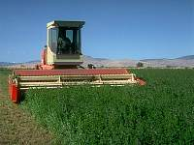
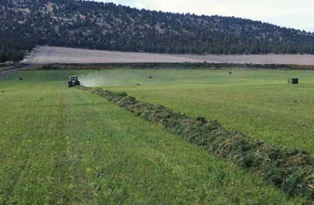
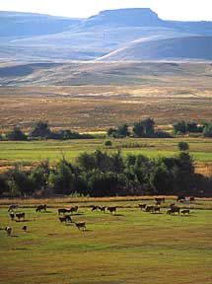
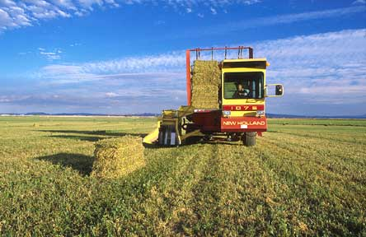
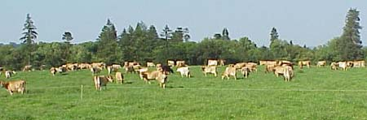
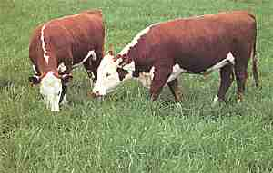




International Forage & Grasslands Curriculum
Forage Quality and Testing
David Hannaway Kimberly Japhet
Crop & Soil Science Department
Oregon State University
Peter Ballerstedt
Forage Products Manager
Barenbrug USA
Adapted from the (US) National Forage & Grassland Curriculum
http://forages.oregonstate.edu/nfgc
Primary Source:
Forages: An Introduction to Grassland Agriculture Ch. 16

Slide 2
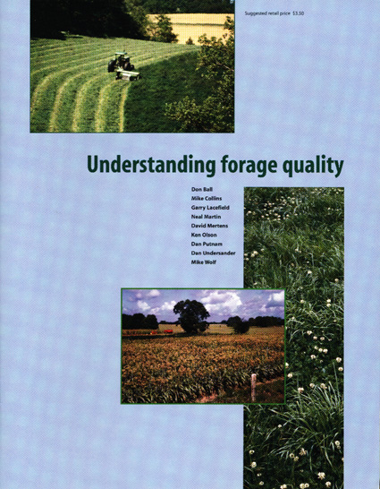
Overview
  Purpose: to help students understand that the quality of forages directly influences the animal and their products.

Slide 3
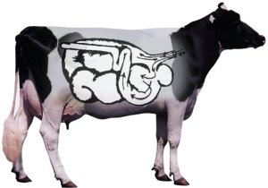
Overview (continued)
  Discussion of general concepts of forage composition, factors affecting quality, forage sampling, forage analysis and how to interpret lab reports will help students understand forage quality.
Ruminants and other herbivores can utilize high-fiber feedstuffs because their digestive tracts are inhabited by microbes that can break down structural carbohydrates.

Slide 4
Student Learning Outcomes
Be able to …..
Define forage quality and describe management decisions that increase forage quality.
List and discuss important factors that determine hay and silage quality.
List and define the components of forage.
Describe methods for determining quality (including CP, NDF, ADF, and TTNDFD).
Define and discuss antiquality factors affecting animal health.
Discuss the need for and progress towards standards in national forage testing.

Slide 5
Define forage quality and describe management decisions that increase forage quality
What is forage quality?
  The capacity of a forage to supply animal nutrient requirements.
  Includes characteristics that make forage valuable to animals
  Characteristics affecting consumption and utilization. (Will the animal consume it and be able to digest it?)
      Palatability (acceptability)
      Chemical composition
      Digestibility of the nutrients
  Capacity to supply animal requirements. (Once digested, will the forage provide the needed nutrients for growth and health?)

Slide 6
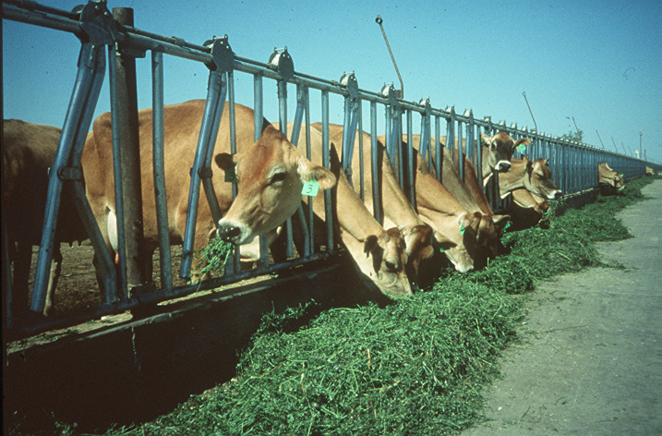
Define forage quality and describe management decisions that increase forage quality
What is forage quality?
...it encompasses nutritive value and voluntary intake and effects of antiquality constituents
Nutritive value: nutrient concentration, digestibility, and end-products.
    Voluntary intake: quantity of dry matter animals will consume when available in unrestricted supply (ad libitum).
    Antiquality constituents: chemical compounds that have negative effects on intake or produce negative responses in animals consuming the forage.

Slide 7
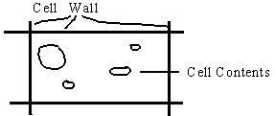
Define forage quality and describe management decisions that increase forage quality
Forage composition has two primary divisions:
Cell contents – digested rapidly and completely.
Cell walls – digested slowly and partially.

Slide 8
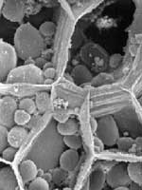
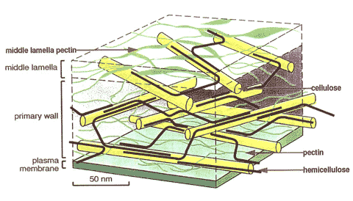
Define forage quality and describe management decisions that increase forage quality
Cell contents
  Non-structural carbohydrates
    sugars, starches, fructosans
  Protein and NPN
    60-80% protein; amino acids, nitrate
  Minerals
    P, S, K, Mg, Ca, etc.
Cell wall
  Structural carbohydrates
    cellulose and hemicellulose
  Lignin and other phenolics
    indigestible; 3-12% of DW
  Cutin
    waxy outer covering
  Silica

Slide 9
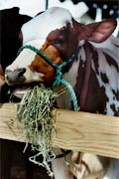
Define forage quality and describe management decisions that increase forage quality
Voluntary intake
Limited by cell wall concentration.
Energy requirements of the animal important.
Heat stress reduces intake.

Slide 10
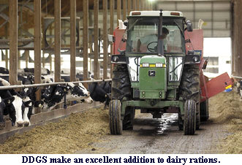
Define forage quality and describe management decisions that increase forage quality
Management decisions
  What species should be planted for use as forage?
  Stage of maturity the forage is in when harvested?
  How to maintain the quality?
    Handling, storage and feeding will reduce quality.

Slide 11
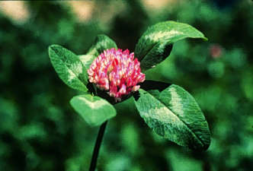
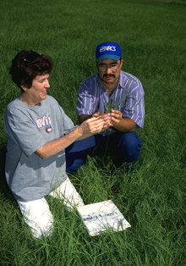
List and discuss important factors that determine hay and silage quality.
Factors affecting forage quality
Plant species and mixtures and cultivars
  Legumes vs. grasses / mixtures
    Legumes are higher in protein and have faster rates of fiber digestion.
  Cool-season vs. warm season
    Cool season grasses are more digestible due to anatomy differences.
  Breeding can improve quality and maturity differences can be large.
Temperature
  Plants grown at high temperatures produce lower quality forage due to lignification.

Slide 12
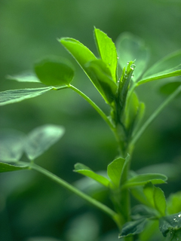
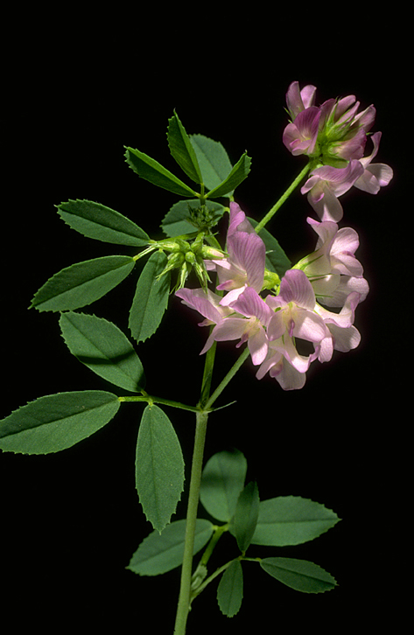
List and discuss important factors that determine hay and silage quality.
Factors affecting forage quality
Maturity stage
  Maturity stage at harvest is the most important factor determining forage quality of any species.
  Forage quality declines as maturity advances.

Slide 13
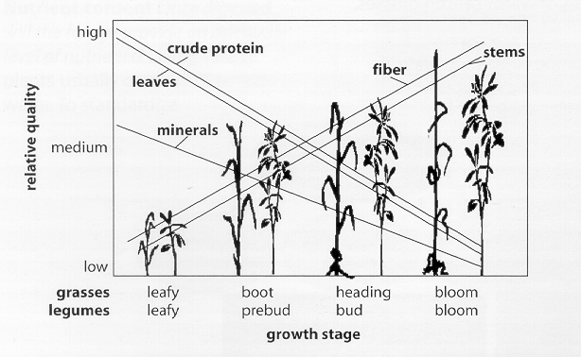
Maturity stage:
Forage quality declines rapidly with advancing maturity.

Slide 14
List and discuss important factors that determine hay and silage quality.
Factors affecting forage quality
Leaf-to-stem ratio
  Leaves are higher in quality than stems.

Slide 15
List and discuss important factors that determine hay and silage quality.
Factors affecting forage quality
Fertilization
  Most important for grasses; N fertilization increases yield and crude protein (%N*6.25).
Harvesting and storage techniques
  Field losses include rain damage, leaf loss, and plant respiration.
  Storage losses to uncovered bales can be 40%.
Foreign material
  Dirt, weeds, wire and straw are all considered foreign material.
  High quality hay will have little to no foreign material.
Antiquality factors
  High quality forages should be free of antiquality factors that discourage animal consumption.
  Can be chemical (toxins) or physical (thorns).

Slide 16
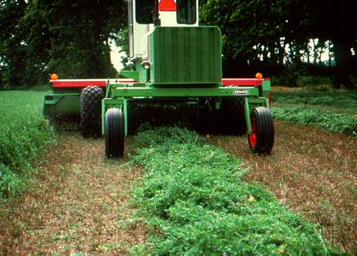
List and discuss important factors that determine hay and silage quality.
Managing for high quality:
Choose adapted species.
Include legumes.
Fertilize and control pests.
Harvest at early maturity stage.
Protect from deterioration.
Allow adequate re-growth time.
Timely operations are key to successful farming and ranching.

Slide 17
List and define the components of forage.
Nutrients for livestock production include:
  Carbohydrates
  Fats
  Proteins
  Vitamins
  Minerals
  Water

Slide 18
List and define the components of forage.
Carbohydrate and Fat → Energy (calories)
  Energy = the potential to do work
  Can be measured as calories, in the U.S., and the joule, in international areas
  One calorie is the heat required to raise the temperature of one gram of water from 16.5 ° to 17.5 ° C (1 calorie = 4.184 joules)
Livestock diets required a lot of energy and since one calorie is so small, kilocalorie and megacalorie are often used
    1 kilocalorie = 1,000 calories
    1 Mcal = 1,000 kcal or 1,000,000 calories

Slide 19
List and define the components of forage.
Energy (cont.)
  Can be measured as total or gross energy (GE)
    Often the energy available for work is measured as digestible energy (DE)
      Calculated after the energy lost in feces is subtracted
      Can be expressed as an amount (kcal/g) or a % of GE
      Carbohydrates have 4.2 kcal/g of energy, fat has 9.4 kcal/g and protein has 5.6 kcal/g
      Total digestible nutrients (TDN) can be calculated by total the digestible crude protein, digestible carbohydrates and 2.25 times digestible crude fat.
    TDN is a commonly used measurement but not recommended as the best for ruminant animals because of microorganisms in the rumen

Slide 20
List and define the components of forage.
Energy (cont.)
  Metabolizable energy (ME)
    Account for the 3-5% of energy that is lost in urine and 3-10% of the energy that is metabolized to methane that escapes from the rumen as eructated (belched) gases.
    Subtracting these losses from the DE leaves the ME
    DE is converted to ME by multiplying DE by 0.82
  Net energy (NE)
    The amount of energy available to the animal for maintaining bodily functions (Nem) and producing new products (NEp) after some energy is used to metabolize the consumed food
      New products also include growth (NEg), milk (NEl), and reproduction (NEy)

Slide 21
List and define the components of forage.
Protein
  Complex combinations of amino acids
    Amino acids are the building blocks of all cells and tissues including the blood, skeleton, vital organs, brain, muscles and skin
  Necessary for synthetic processes essential to life
  Forages are tested for crude protein, available protein, unavailable protein, adjusted crude protein and soluble protein
    Crude protein (CP) is the most often used expression

Slide 22
List and define the components of forage.
Minerals
  15 + minerals are categorized as either macrominerals or microminerals
    Macrominerals include: calcium, magnesium, phophorus, potassium, sodium, chlorine and sulfur
    Microminerals include: chromium, cobalt, copper, iodine, iron, manganese, molybdenum, nickel, selenium, zinc, arsenic, boron, lead, silicon and vanadium
  Minerals are listed as a percentage of the total sample taken for testing or in parts per million (PPM) for some minerals
  Since certain minerals may be toxic to livestock if found in large quantities and deficiencies may result in declining animal health and performance, mineral content should be considered in the quality of the forage

Slide 23
List and define the components of forage.
Vitamins
  Vital for animals for various functions and needed to efficiently utilize other nutrients
  A, D, E, K, B12, Thiamin, Niacin, and Choline are needed
  Supplements can be used but add to the expense of feed

Slide 24
List and define the components of forage.
Water
  Much of the water consumed by livestock is within feedstuffs
  Vital for body temperature regulation, growth, reproduction, lactation, digestion, metabolism, excretion, and many other functions
  Amount needed will vary according to animal size, growth stage, location and type of feed
  Forages are tested for the dry mater content and moisture content to aid in determining quality

Slide 25
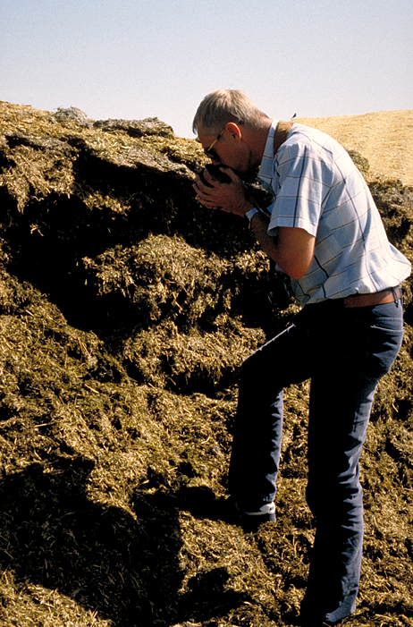
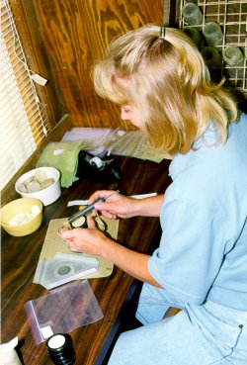
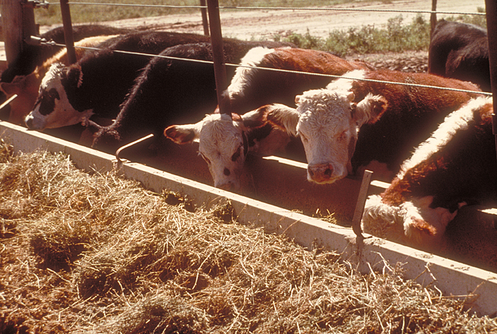
Describe methods for determining quality.
Forage quality can be determined by many ways but the three main methods are:
  Organoleptic (sensory) observation
  Chemical composition
  Feed trial evaluations

Slide 26
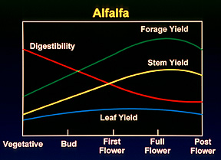
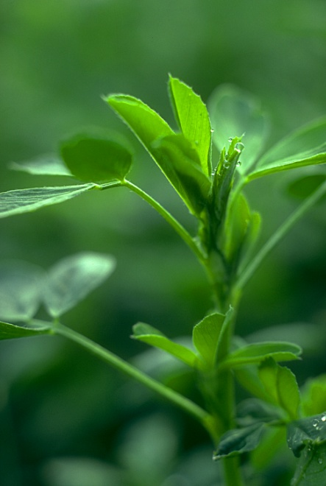
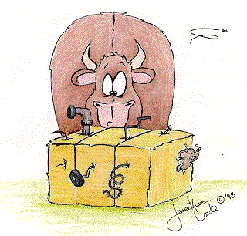
Describe methods for determining quality.
Organoleptic (sensory) observation
  Using the sense organs
  (eyes, nose, taste, ears, touch) to evaluate forage
  Factors to consider include:
    Species
    Maturity stage
    Leafiness
    Color
    Odor and condition
    Foreign material

Slide 27
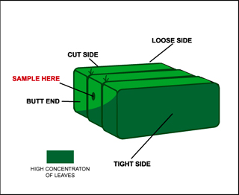
Describe methods for determining quality.
2. Chemical composition (laboratory analysis)
  More accurately determines quality of forage
    Helps livestock manager determine how much forage and supplement are needed for a particular animal and production goal
    Allows for better rationing
  When forage is sampled, sample must be representative of what is being predicted

Slide 28
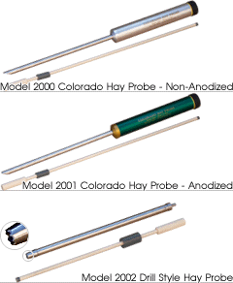
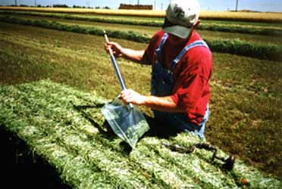
Forage sampling: Hay
Describe methods for determining quality.
Use a core sampler
  Internal diameter 3/8 – 5/8”
Take “enough” samples
  At least 20 per “lot”
Use a sampling plan
  Obtain random sample
Don’t subsample
  Unground samples should not be split

Slide 29
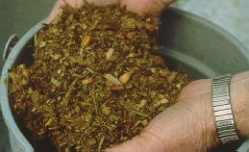
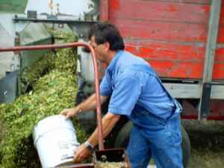
Forage sampling: Silage
Describe methods for determining quality.
Collect 3-5 handfuls of chopped forage from the middle of a load during unloading.
Place in plastic bag.
Refrigerate immediately.
Repeat several times during the day.
Combine samples from single field and mix well.
Store in refrigerator until submitting to laboratory.

Slide 30
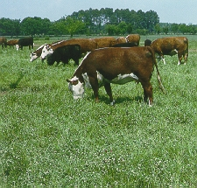
Forage sampling: Pasture
Describe methods for determining quality.
Collect forage randomly from 10-20 places in the pasture.
Observe animals and collect sample to same. height as they are grazing
Refrigerate or air-dry if not sent immediately to laboratory.

Slide 31
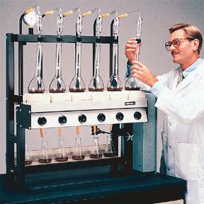
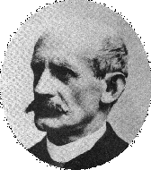
Describe methods for determining quality.
Laboratory analysis: Historical
Proximate analysis system
  Dry matter (DM) – moisture free weight
  Crude protein (CP) – %N*6.25
  (because plant protein is 16% N; 100/16=6.25)
  Ether extract (EE) – lipids and pigments
  Crude fiber (CF) – weak acid and weak base extraction
  Ash – mineral content after combustion at 1100F
  Nitrogen free extract (NFE) – by difference
  (100-CP+EE+CF+Ash)
Nitrogen analysis technique developed in 1883 by Johan Kjeldahl, a Danish chemist.

Slide 32
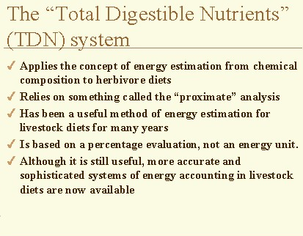
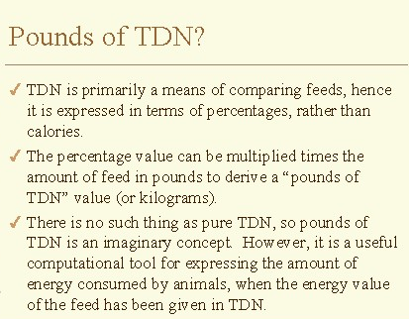
Describe methods for determining quality.
Laboratory analysis: Historical
Proximate analysis does not always adequately characterize the nutritive value of forage carbohydrates
Source: Thomas H. Herdt, DVM, Michigan State University
http://cvm.msu.edu/courses/Lcs643/energy1/sld030.htm

Slide 33
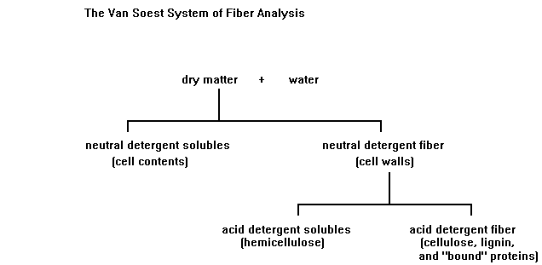
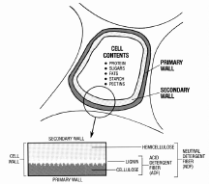
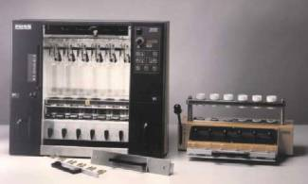
Describe methods for determining quality.
Laboratory analysis: Current
Detergent analysis system (Peter Van Soest)
  Cell walls
  Cell contents
This detergent analysis system more accurately predicts what nutrients the animals can use by distinguishing between cell walls and cell contents.

Slide 34
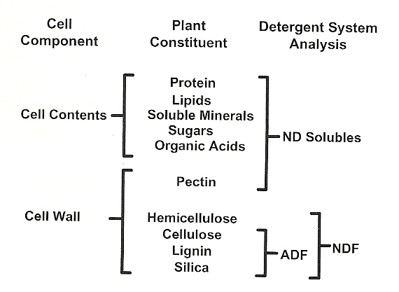
Describe methods for determining quality.
Laboratory analysis: Current
Detergent analysis system (Peter Van Soest)
  Cell walls
  Cell contents
This detergent analysis system more accurately predicts what nutrients the animals can use by distinguishing between cell walls and cell contents.

Slide 35
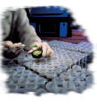
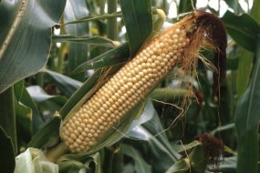
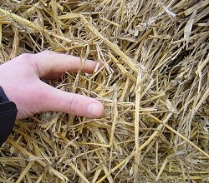
Describe methods for determining quality.
Laboratory analysis: NDF
Neutral Detergent Fiber
  Determined when a sample is extracted with a neutral detergent solution
  Cell contents are largely soluble and the cell wall components are insoluble
  NDF value predicts dry matter intake (DMI)
  [because …. a high NDF means the animal feels full longer because certain components are taking longer to be digested, and … if the animal feels full, it eats less]
  Corn grain is ~ 10% NDF; nearly 90% digestible
  Straw with an NDF of ~ 80%; only 20% digestible

Slide 36
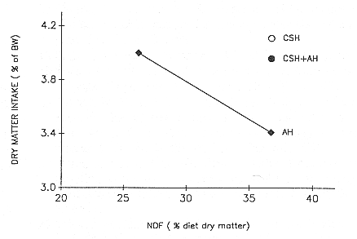
Describe methods for determining quality.
Laboratory analysis: NDF
Neutral Detergent Fiber
  Dry matter intake decreases with increasing NDF
  (negatively correlated)

Slide 37
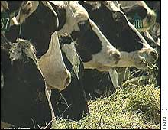
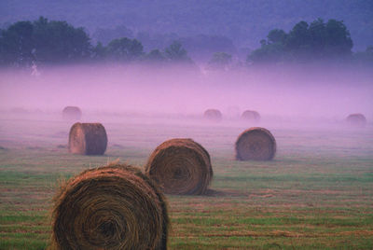
Describe methods for determining quality.
Laboratory analysis: ADF
Acid Detergent Fiber
  Sample is extracted with a sulfuric acid detergent solution
  Cell walls are partially digestible with cellulase
  ADF value predicts digestible dry matter (DDM)
  Corn grain is ~ 3% ADF
  Dairy quality alfalfa is < 30% ADF
  Late maturity grass hay and straws may be > 50% ADF

Slide 38
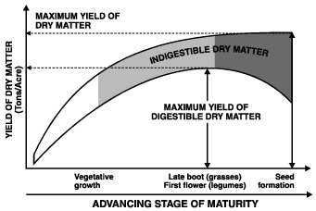
Describe methods for determining quality.
Laboratory analysis: ADF
Acid Detergent Fiber
  Digestible Dry Matter decreases with increasing ADF (negatively correlated)

Slide 39
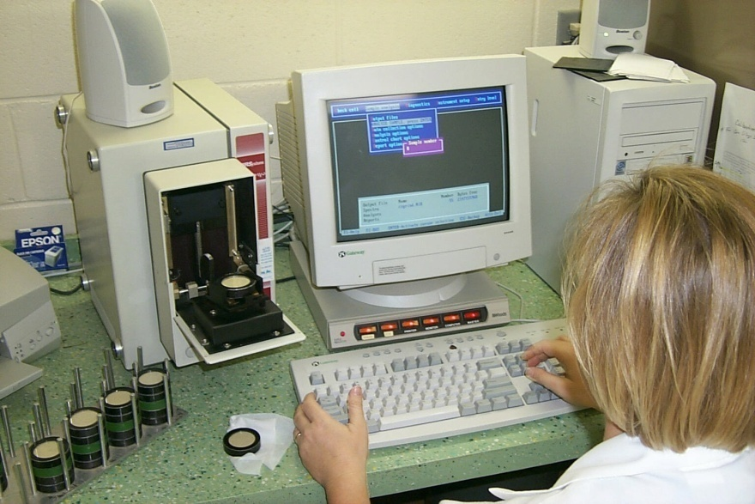
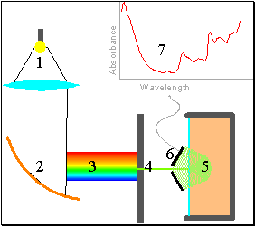
Describe methods for determining quality.
Laboratory analysis: NIRS
Techniques developed by years of applied research by USDA ARS scientists.
Improved and has become popular in last decade.
Fast and precise, but must be adequately calibrated to be accurate.
A special lamp emits energy into a grating that separates it into a rainbow of wavelengths between 1100 and 2500 nanometers. The energy is focused onto a sample of material, and detectors read the patterns of reflectance.
Source: http://mark.asci.ncsu.edu/nutrit~1/Miscellaneous/theo96csnc.htm

Slide 40
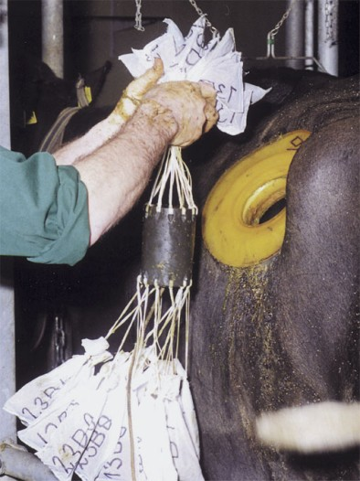

Describe methods for determining quality.
3. Feed Trial Evaluations
  Ultimate evaluation
    In vivo and in vitro digestibility measures
    Feed – Fecal = Digestible
  Costly and require proper sampling but are faster and more specific

Slide 41

Interpreting forage analysis reports
Describe methods for determining quality.
Values will be reported for:
Dry matter / moisture: for “as fed” and “dry matter basis”
% Nitrogen
  (crude protein = %N * 6.25)
Fiber analyses
  NDF and ADF
Mineral analyses
  Ca, P, Mg, K, S
Calculated values
  TDN, NEm, Neg, NEl, RFV

Slide 42

Relative feed value (RFV)
Describe methods for determining quality.
What is it, why is it, and how is it calculated?
  RFV was developed to provide a single value for comparing forages
  Higher RFV values indicate higher quality forage
  (in contrast to NDF and ADF numbers being inversely correlated with quality)
  RFV is calculated as follows:
    RFV = (DDM * DMI) / 1.29
    where DDM = DM digestibility (%)
    DMI = voluntary DM intake (% of BW)
    DDM = 88.9 – (0.779 * ADF)
    DMI = 120 / NDF
  PEAQ: Field estimates of RFV being developed for various heights and maturity stages
  (see the following URL: http://peaq.outreach.uiuc.edu/)

Slide 43
Define and discuss antiquality factors affecting animal health.
Antiquality characteristics are traits that make plants undesirable for consumption and can be physical, like thorns or secondary metabolites, unpleasant odors or tastes.
Antiquality characteristics include things that contribute to:
  Illnesses
  Poor animal gains
  Low consumption
  Reproductive difficulties

Slide 44
Define and discuss antiquality factors affecting animal health.
Livestock will often not select plants with physical antiquality factors such as thorns, molds, dust or weeds if there is another choice available.
  These unpalatable traits reduce intake and may decrease microbial activity in the rumen, reducing digestibility.
Most antiquality factors are chemically based.
  This results in undesirable tastes and odors which influence selection and palatability by the animal.
  Some cannot be detected by taste or smell and are toxic leading to health problems.

Slide 45
Define and discuss antiquality factors affecting animal health.
Common antiquality components include:
  Lignin: reduces digestibility; late maturity forage has more lignin, less palatable
  Tannins: reduce palatability
  Saponins: can cause bloat
  Coumarin (sweet clover): anticoagulant
  Flavonoids: can lead to reproductive failures
  Nitrates: nitrate poisoning
  Endophytes (perennial ryegrass and tall fescue): toxic ergoalkaloids (Lolitrim b and ergovaline)
  Alkaloids: reduce palatability

Slide 46
Discuss the need for and progress towards standards in national forage testing.
Several different tests are used to test forage quality in different states and countries; standardizing forage testing would improve marketing across state and national borders.
  Hay is the most common forage bought and sold
  Alfalfa is the most common type
U.S. Alfalfa Hay Test was developed to precisely express feed value. The test includes:
  Uniform sampling
  Uniform testing; analyses and methods
  Uniform reporting methods to facilitate marketing and ration formulation

Slide 47
Discuss the need for and progress towards standards in national forage testing.
History of forage testing
  1958 – California developed a test for modified crude fiber (MCF)
    The MCF score predicts the total digestible nutrients (TDN) with good accuracy
  Late 1960’s – Nevada developed a system for predicting digestible energy using CP and ADF
    This led to grades for Alfalfa hay

Slide 48
Discuss the need for and progress towards standards in national forage testing.
History of forage testing
  1976 – American Forage and Grassland Council (AFGC) and University and Federal Research and Extension personnel developed a forage evaluation system based on chemical analysis
    This system closely approached actual feeding trials in determining the feeding value of hay
    5 hay grades and 1 sample grade for all legumes and grasses were developed
      They included CP, NDF, ADF, and RFV
    The grades were not adopted by the Federal Grain Inspection Service due to mixed industry support

Slide 49
Discuss the need for and progress towards standards in national forage testing.
History of forage testing
  1980, 1982 – a group of western scientist and later a national group met and a U.S. Hay Quality steering committee was established called the National Hay Test Committee
    This group included research, extension, and commercial interests
  1983- a common standard, called the U.S. Alfalfa Hay Test, was accepted by the National Hay Test Committee
    This standard included dry matter (DM), acid detergent fiber (ADF), estimated digestible dry matter (EDDM), and crude protein (CP).

Slide 50
Discuss the need for and progress towards standards in national forage testing.
Current situation
  National Forage Testing Association (foragetesting.org)
    The NFTA is a joint effort of the American Forage and Grassland Council, National Hay Association, and forage testing laboratories to improve the accuracy of forage testing among laboratories.
    Since its formation, reproducibility of lab results among laboratories has dramatically improved. Various lab methods have been reviewed and improved.
    Over 150 laboratories annually participate in the certification process.
    A list of NFTA Certified Laboratories is available online.

Slide 51
Summary of Forage Quality and Testing
High-quality forage fed to livestock in sufficient quantities will result in improved animal performance.
Forage quality is the most significant factor affecting how much forage and supplement will be required each day.
Forage quality can be measured several ways including visual (organoleptic) methods, chemical analysis, and feeding trials.
Stage of maturity has the greatest influence on forage quality.
Forage quality is most greatly influenced by how it is managed.
Use approved methods for sampling and a NFTA certified laboratory for testing.

Slide 52

Summary of Forage Quality and Testing
The primary purpose of growing forage crops is to feed animals. Factors affecting intake and digestibility are of central importance in forage management.
Cell walls and cell contents are affected by species selection, fertilization, and harvest timing.
Maintaining forage quality at time of harvest is a function of harvesting techniques and storage conditions.

