Slide 1
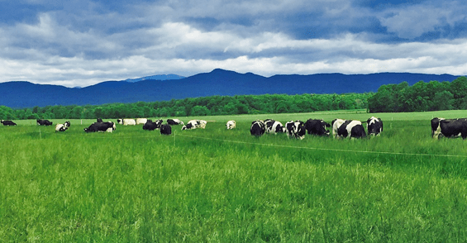
Soil Health and Grazing
Shannon Cappellazzi PhD
Soil Health Institute
Courtesy Faculty OSU
June 27, 2019

Slide 2
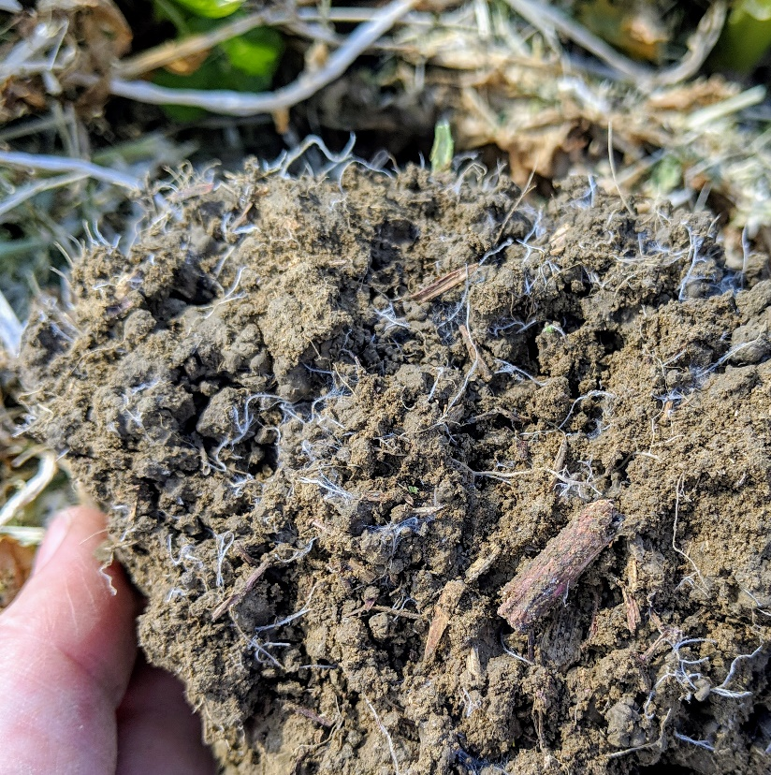
SOIL HEALTH IS:
The continued capacity of a soil to function as a vital living ecosystem that sustains plants, animals, and humans
Notes:
This is a change from the standard focus on just the chemical and physical characteristics of the soil, Soil Health Science incorporates the impacts of the biology. Not just the biology in and of itself, but the interactions and influence of biology on chemical and physical reactions because SOIL is a LIVING ECOSYSTEM with organisms actively controlling chemical and physical characteristics of the soil. When we adjust our thinking to a living ecosystem we have to think about what an organism needs to survive. Water, Food, and Shelter are the bare essentials. In soil, most organisms need Carbon for food, they use this as energy and the building blocks to build their shelter and hold water and transform their food. So for this living ecosystem to be healthy, that is, to function, it needs carbon. If there was one soil nutrient that has been overlooked on soil test results, it is carbon. Just because the plants don’t need to get it from the soil, doesn’t mean the system does not need the C to be there. Soil carbon is used and cycled by the microbial community to influence the efficacy of each function within this vital living ecosystem
When you think about what a healthy soil is like, what words come to mind. Describe the look, feel, touch, smell, sounds
So what you are describing is something that might look like this
Soil scientists have been trying to describe what that means succinctly for a long time. The definition we are working with is:
That means..
We will talk about the functions of soil in just a minute, I want to emphasize that living organisms in the soil perform these functions
Just like with livestock, how we manage the habitat and feed for our microbes, will impact how well they perform their functions
To quantify how healthy a soil is, we must think about whether or not it can function
Functions are driven by living organisms
Living organisms are affected by management

Slide 3
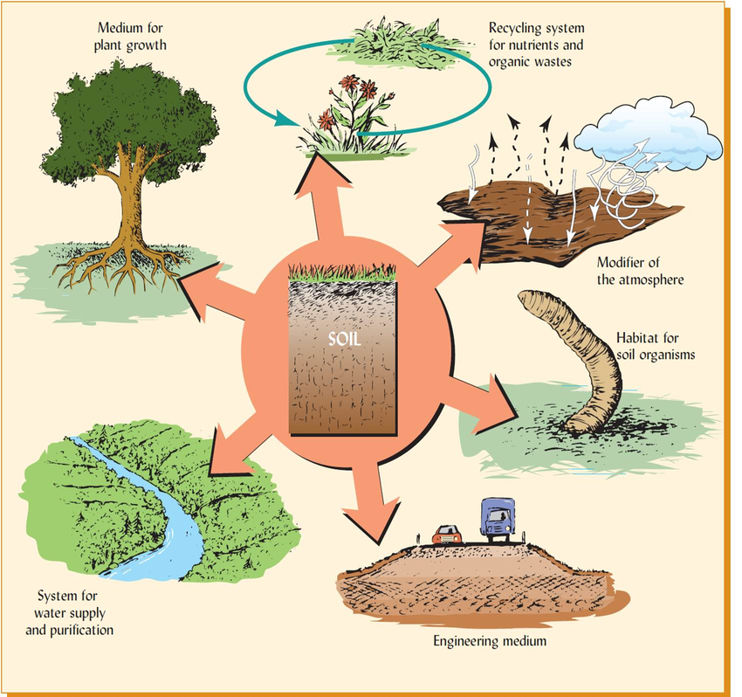
6 functions of soil
Medium for plant growth
Recycling nutrients = decomposition
Modifier of atmosphere
SOIL
Habitat for organisms
Water supply and purification
Engineering medium
Notes:
Okay, so __ of you have taken soils, these pictures will help, what are the 6 main functions of soil
Other “functions” provision of food wood fiber and raw materials
Flood mitigation
Filtering nutrients and contaminants – detoxification of recycling of wastes
Regulation of pests and disease
Information storage – cultural and climate record

Slide 4
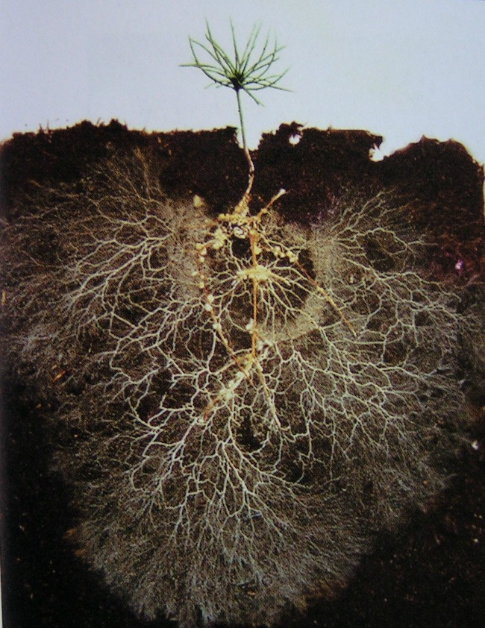
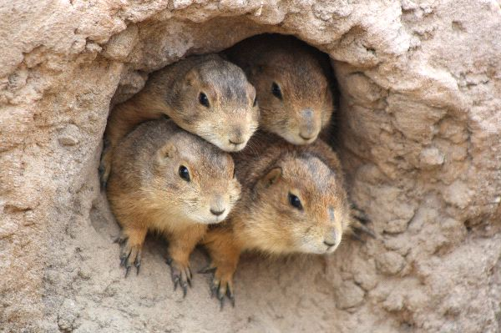
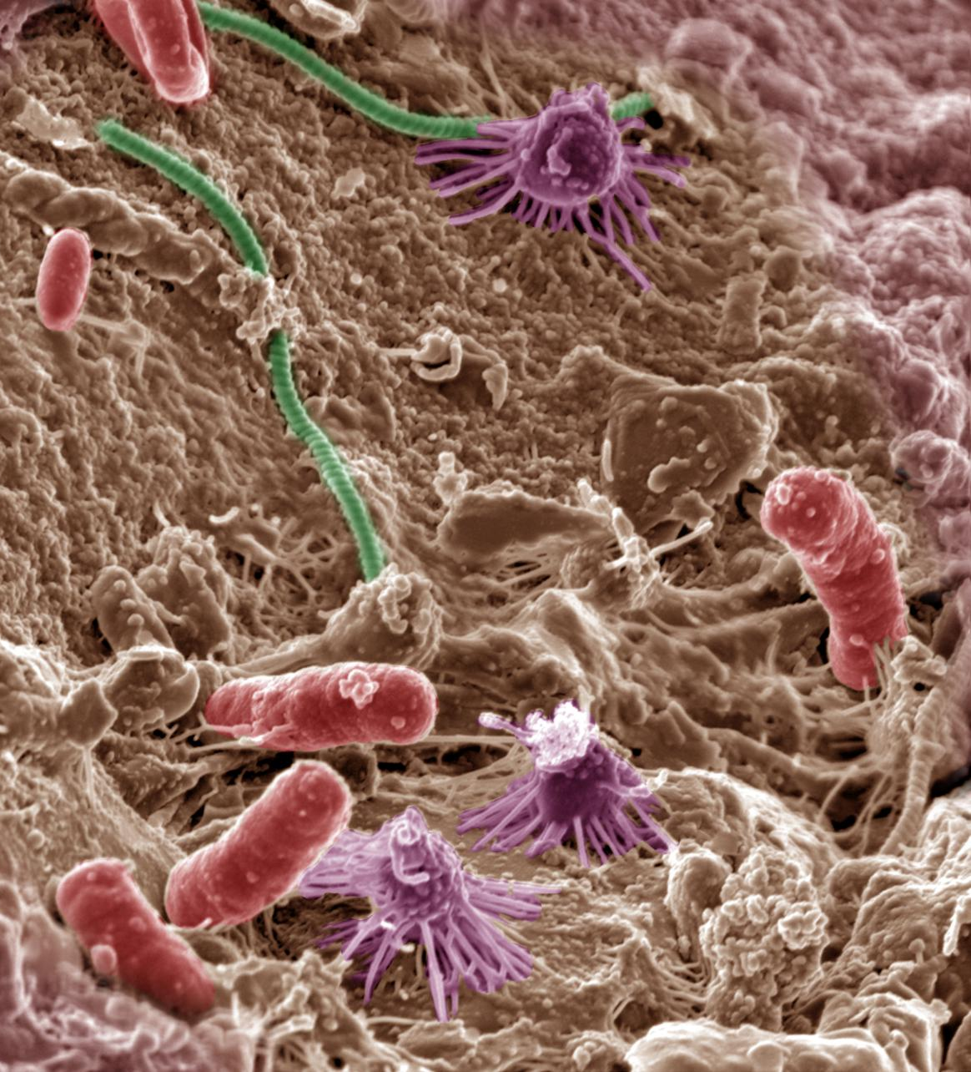
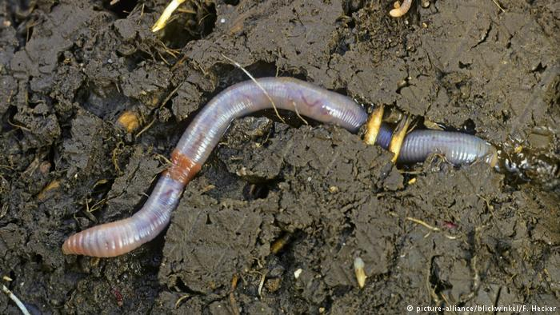
Habitat for Organisms
We all know worms, fungi, plants
But we must consider macro
And importantly MICROBES
Notes:
What do we mean by habitat?
It is the natural home or environment of an organism – the preferred surrounding – in order to be preferred it will provide Food, Shelter, Water

Slide 5
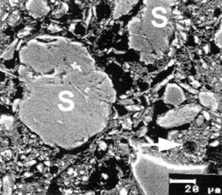
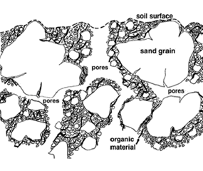
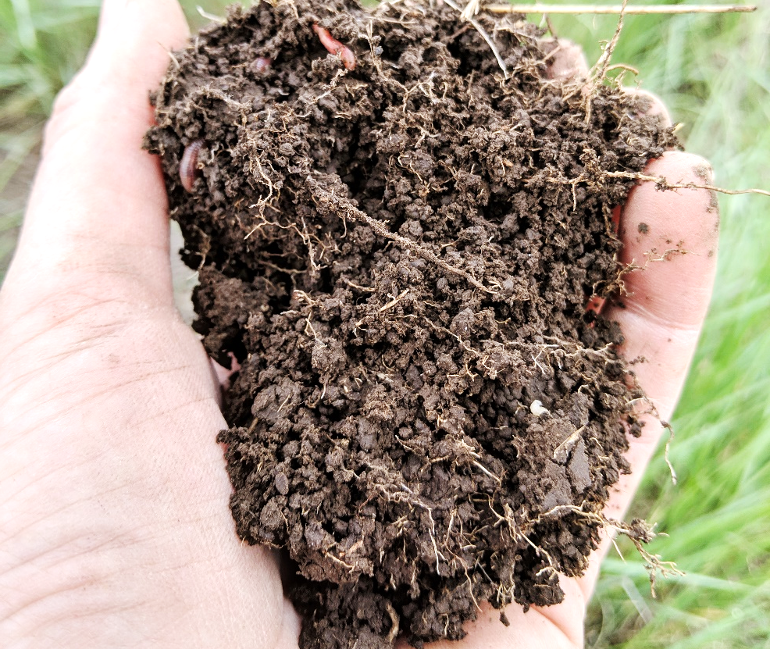
Microbial Habitats – Soil Aggregates
Various mineral particles stuck together
Chemical forces of attraction
Plant and hyphal physical forces
Organisms exuding microbial glues
Notes:
It is a bit harder to think about what habitat means on the microbial scale
They still need their habitat to provide the same things
Shelter/protection from predators/environment, food, water, = requirements for reproductive success
Microbes live in the space between particles
Soil particles that are stuck together in various arrangements provide the physical space for microbes to live
How big is the average bacteria? Many 1-2um wide and 5-20 um long, can be as big as 100um long

Slide 6
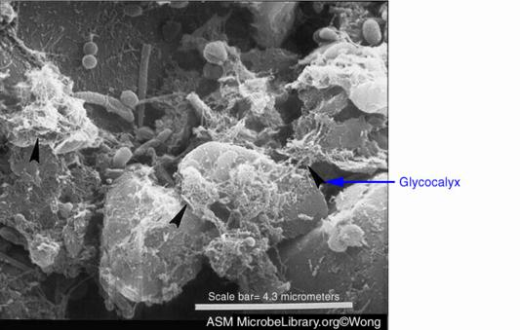
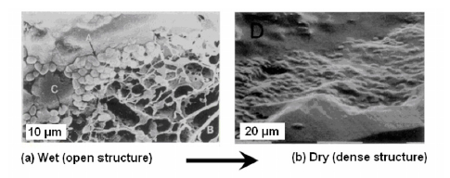
Microbial Habitat – Extracellular Polymeric Substances
Microbes embed in matrix
Glues minerals
Polysaccharides, proteins, nucleic acids, lipids
Holds water – prevent desiccation
Traps food
Keep extracellular enzymes close
Recycle dead microbial contents
Media for horizontal gene transfer
Media for communication
Notes:
This confocal microscope image on sand particles is stained with living organism embedded in a matrix of EPS that makes up a biofilm. These biofilms are multi-species, multifunctional habitats where 90% of microbes live
This is where all of the functions are taking place. I can talk more about this later if desired.

Slide 7

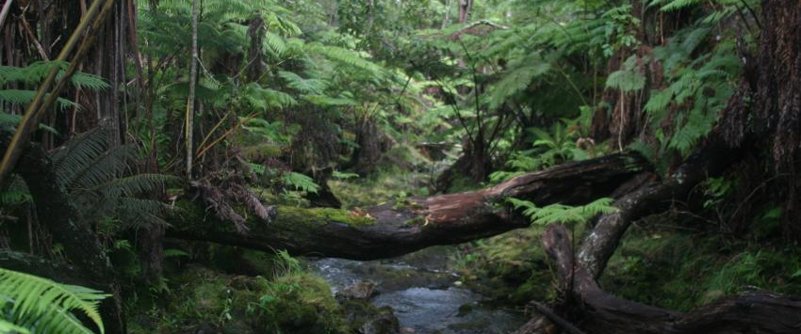
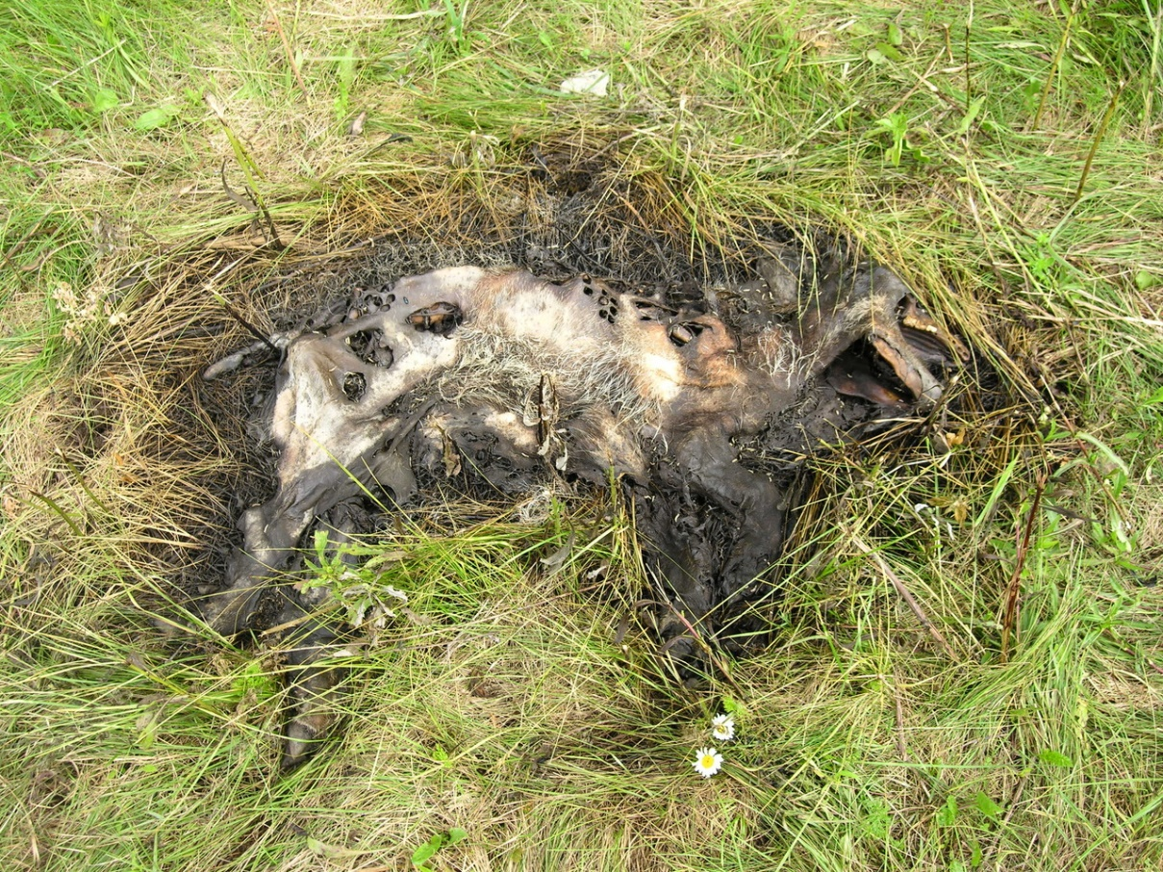
Decomposition – Recycling of Nutrients
Trophic cascades of organisms working to recycle dead organic material
Notes:
What is this?
Without microbes, what would happen to all of the dead bodies?
What does this provide to the soil?
What kinds of organisms are working on this?
Decomposition stages can also be a bit more beautiful.
Consider the dead plant materials in a forest, the litter layer, the downed trees
This is the circle of life

Slide 8
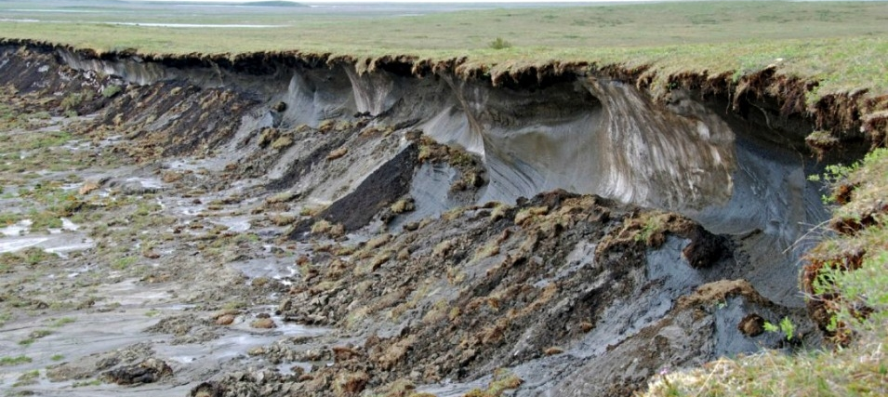
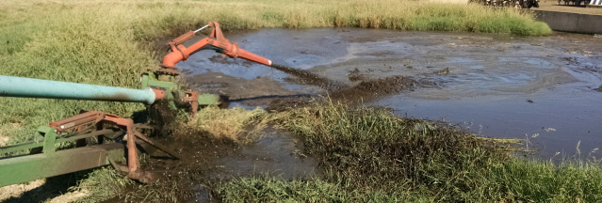
Atmospheric Modification
OM decomposition produces gas
CO₂ is universal aerobic “waste” product
Anaerobic conditions produce N₂O and CH₄
Tillage introduces oxygen to OM that was physically stabilized
OM becomes CO₂
Grazing can be net neutral in C emissions vs storage IF well managed
Notes:
What is, on average, ~ 50% of the volume of a soil?
The topic we hear a lot about right now, is the thaw of the permafrost? Why?
What is in that gas? - Depends on what kind of food the community is getting, and the habitat they are living in.
What does that gas do? What is burning? Extreme oxidation, what is oxidation, the introduction of oxygen into a bond that breaks down the organic matter. CO2 is released, that means less C in soil, more in air.

Slide 9
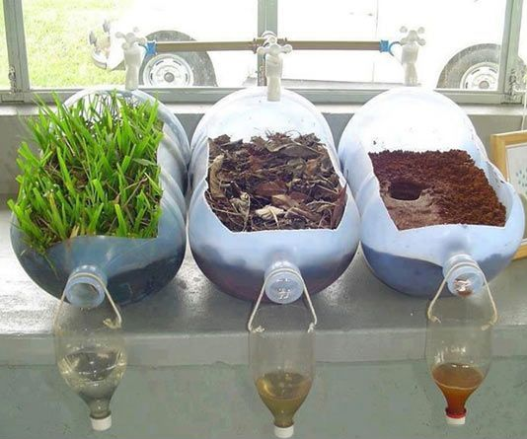
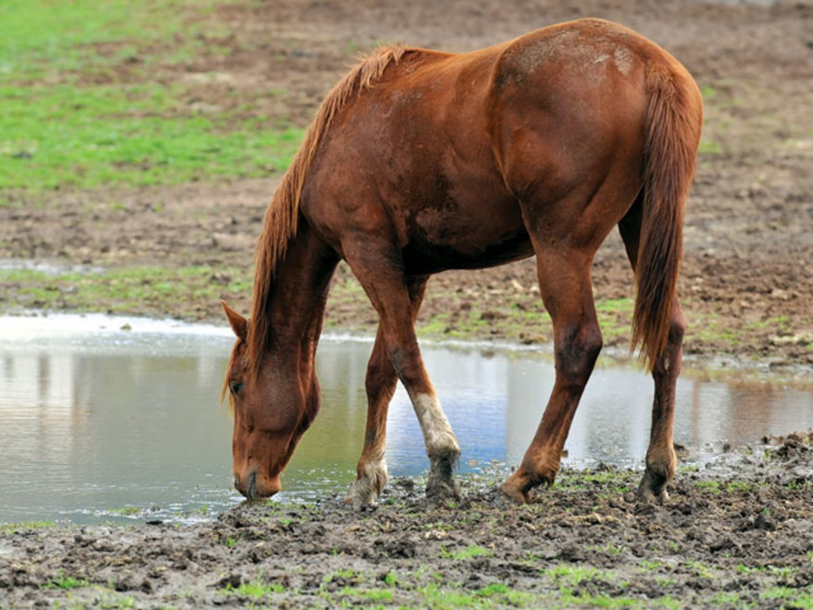
Water Supply and Purification
Organisms form soil aggregates
Aggregates maintain a variety of pore sizes
Variety of pore sizes allow for infiltration
Infiltration reduces ponding, runoff, erosion, crop-protection product loss
Infiltration allows soil to store water
OM allows soil to store more water
Stored water can be used through dry season
Notes:
What function of soil does this picture make you think of
What do you observe in this picture?
What kind of management does each container represent?
Other than living or dead plant material, how else can life impact infiltration and purification?
How does soil biology influence the ability of the soil to perform this function?
Because we all want to avoid this –pic
Here we can consider, how soil health might directly impact animal health

Slide 10
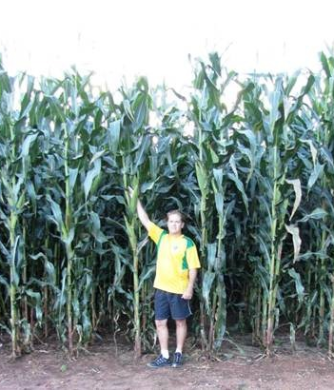
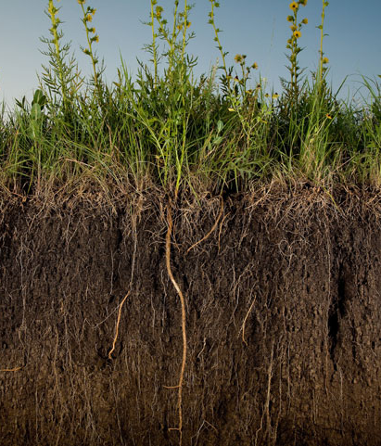
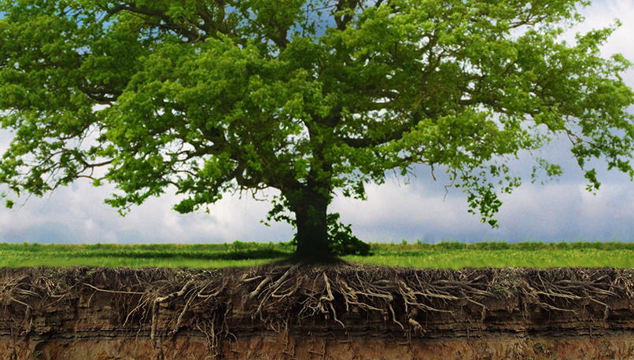
Medium for Plant Growth
Provides Nutrients
Stores and cycles
Provides Water
Infiltrate, filter, store, and deliver water
Creates Structure
Root anchor
All other functions influence plant growth
Notes:
This normally the main function we think of.
Soil supports plant growth –
I bet you all can name the ways in which soil allows for plants to grow

Slide 11
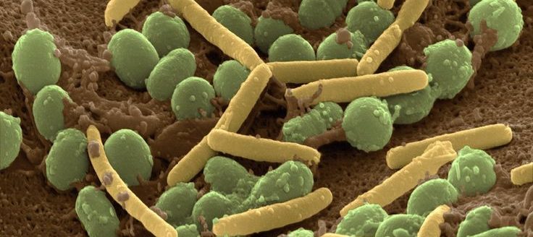
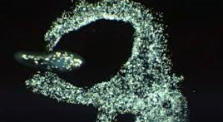
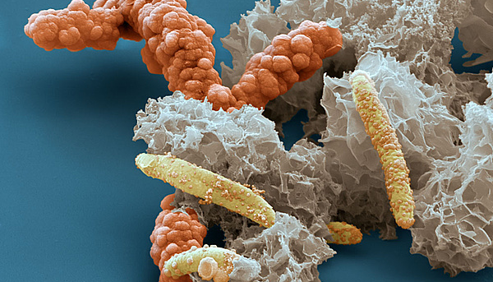
Feed your microbial herd
Most soil bacterial are heterotrophs
Carbon is food and energy
When they have food they:
Build strong structures
Filter contaminants
Store water
Fight pests
Communicate
Reproduce
Notes:
Organisms inherently are made up of a lot of Carbon based compounds we all need carbon
Plants get their carbon from CO2 so traditionally in soil testing we didn’t even measure C
This was because we didn’t understand that the microbes can do the work for us
If we feed the microbes, they will take care of our soil!!!!
Of course they need a balanced diet, but the majority of their need is C
Just like in soil fertility or animal nutrition, the lack of one major nutrient can shut down function.
If we need Fe as an enzymatic cofactor for photosynthesis, and there is no Fe, that enzyme will not work. Many microbes have one or maybe only a couple of functions they perform. If the nutrient they need is not around, they go dormant or die. Until that nutrient is available, the function will not happen
Without enough C almost nothing happens.

Slide 12
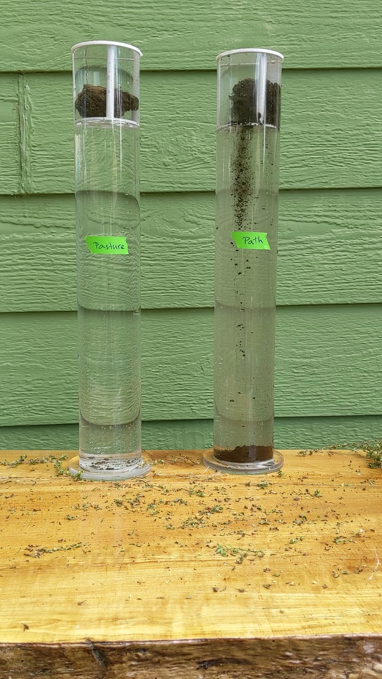
Protect the habitat structure
Microbes live PORE SPACE
Microbes are anchored to surface and holding particles together
Aggregate stability is impacted by inherent texture and organisms
Stronger the aggregate stability the less likely the microbial habitat will be disturbed
Notes:
Aggregate are more stable when we reduce disturbance
Aggregates are more stable when there is more diversity
Aggregates are more stable when we feed the microbial herd
Pore space is the key, aggregates are great because it gives us a variety of pore sizes, and maintains pore volume
This allows for water to be both held, and available
This allows for many different kinds of organisms to move around the mineral particles
The microbes are attached the surface of the soil particles, the EPS often continues across many particles gluing them together, creating the rebar of the structure for their homes. Making sure the particles don’t settle together and crush them
If the aggregates don’t change shape when water or pressure is applied, they can continue to function
Grazing has a lot of benefits when is comes to maintaining structure
Often there is little tillage to physical break up the soil habitat community
Often there are multiple above ground species, so multiple kinds of litter, and many different organisms that are able to reproduce because they can eat what they want to eat
There is a great nutrient source from the animals themselves

Slide 13
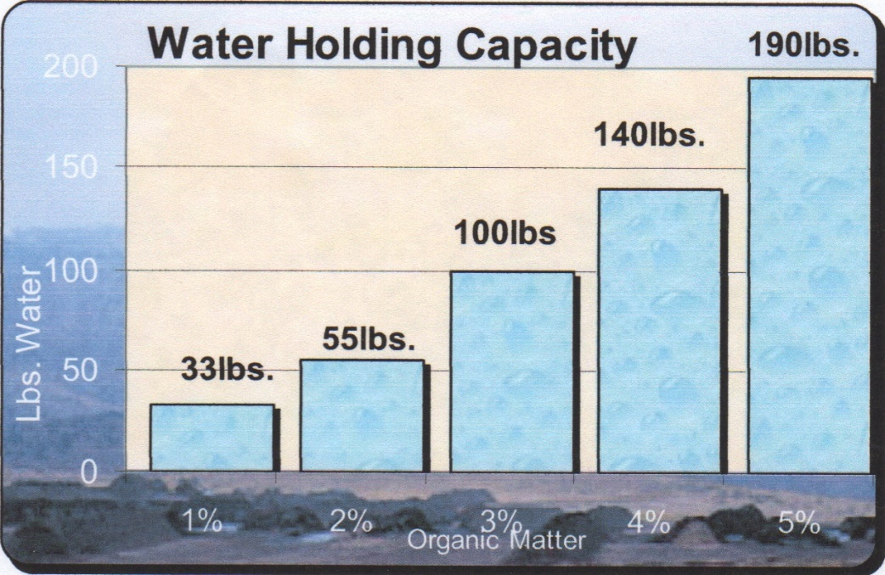
Soil Carbon Increases Water Holding Capacity
200
150
100
50
0
Water Holding Capacity 190lbs
OM holds water
ESP holds 500x water
Stable aggregates create a variety of pore sizes, allowing for:
Increased infiltration
A large pore volume for water to be stored
Variations in water holding tension so plants can still get at it
Water (lbs)
1% 2% 3% 4% 5%
Organic Matter
Notes:
Increasing OM 1% in soil can increase available water holding capacity by around 50%

Slide 14
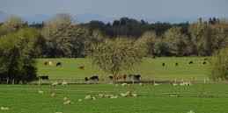
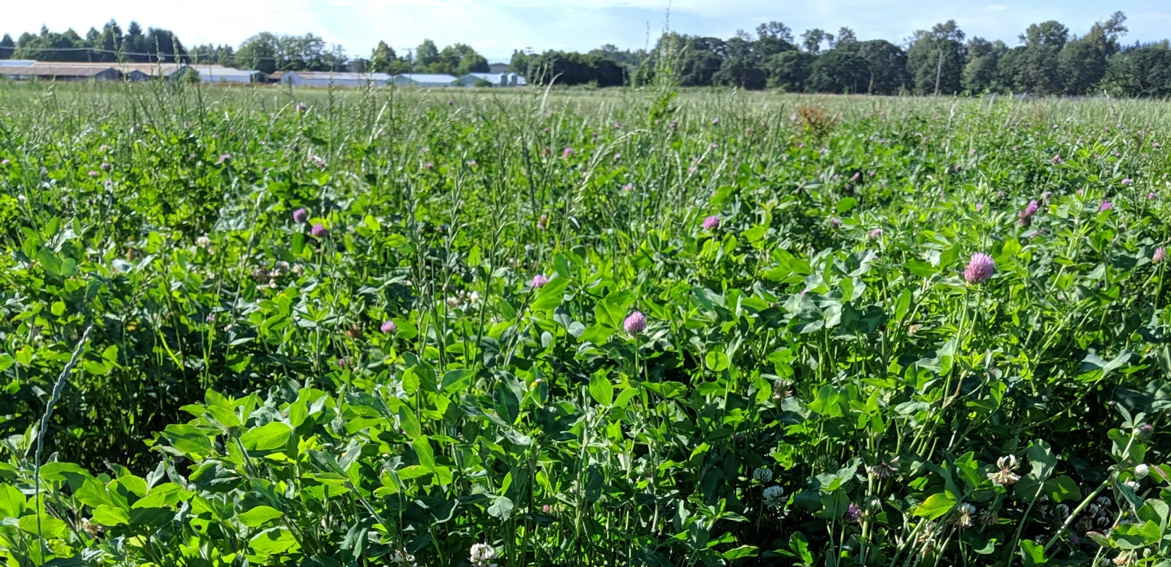
Grazing should be good for soil health
Maintain living roots
Keep it covered
Reduced disturbance
Maximize biodiversity
Add organic matter
Notes:
Provide nutrient inputs = food
Manure and urine provide direct nutrients
Eating plants triggers root exudation
Pastures are covered year round providing food to microbes 365 days a year
Reduced tillage disturbance = habitat
Fungal hyphal networks are not broken or killed
Aggregates are allowed to form and stabilize
Organic matter is not oxidized as quickly
Decent diversity = resiliency
Above ground diversity impacts below ground diversity
Provides functional redundancy
Leads to resilience of system

Slide 15
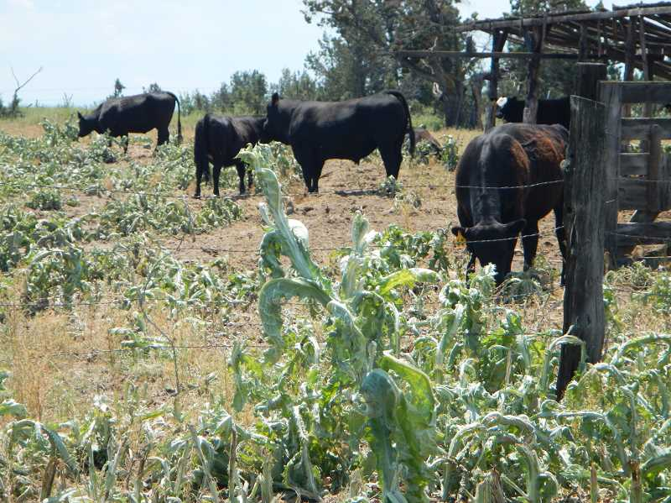
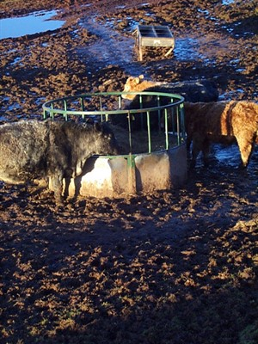
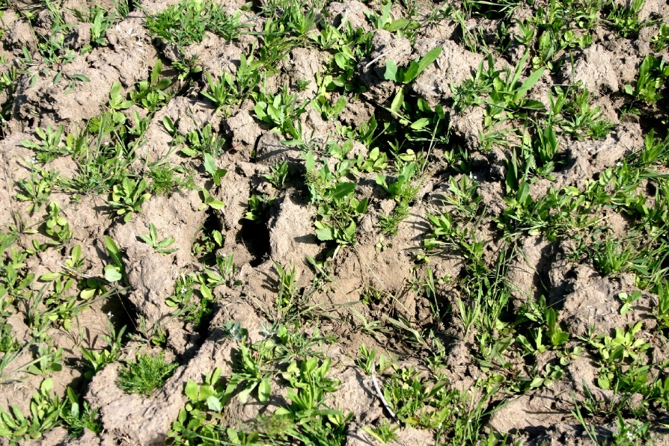
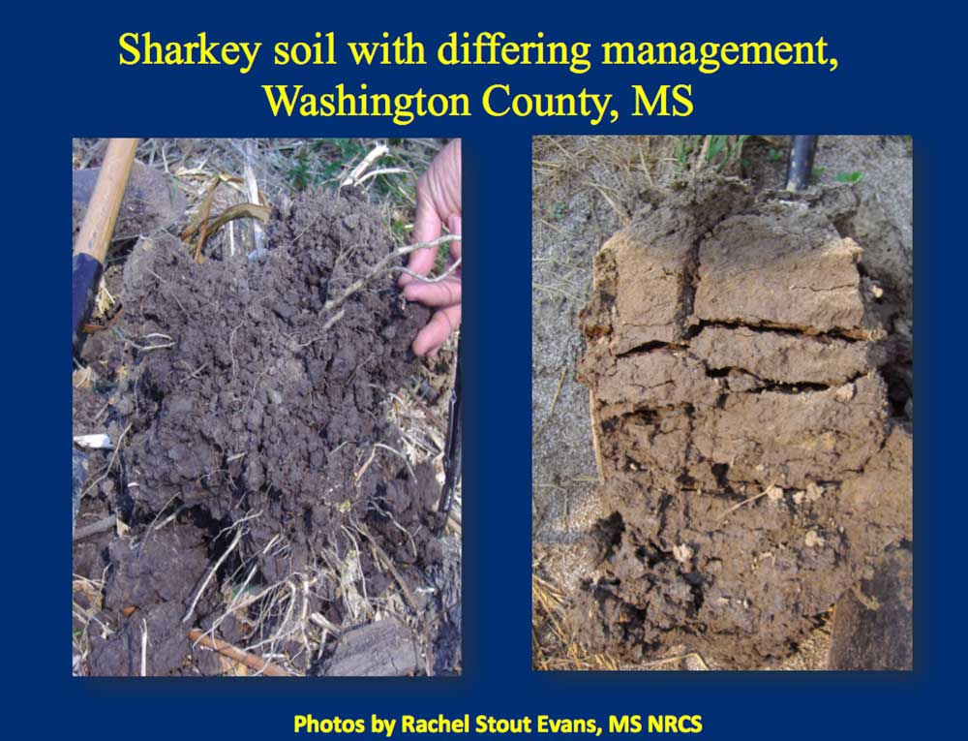
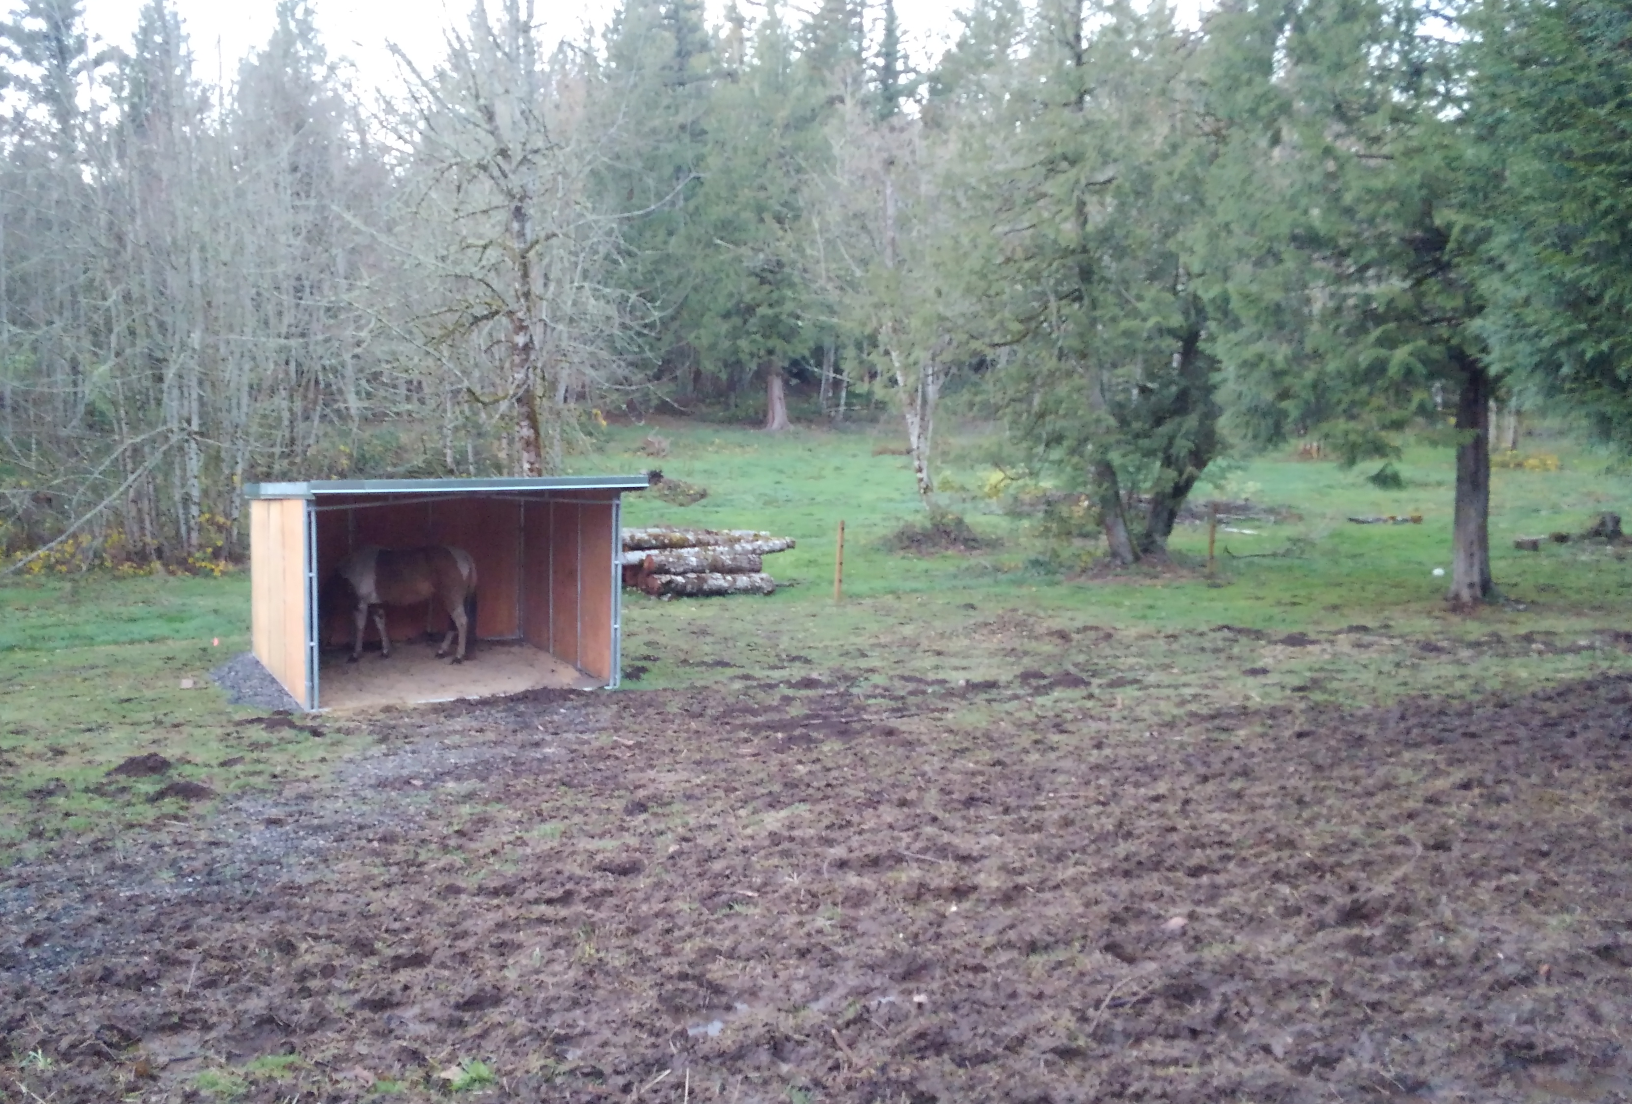
Management makes all the difference

Slide 16
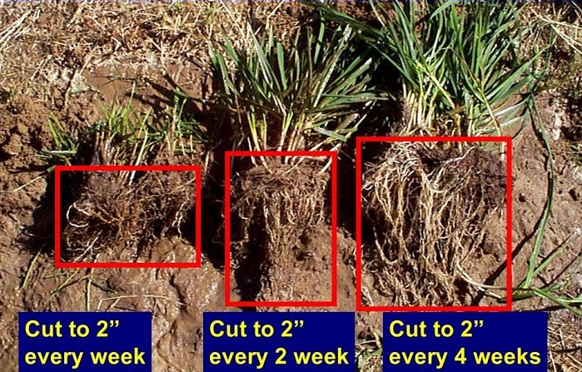
Roots Rely on Recovery

Slide 17
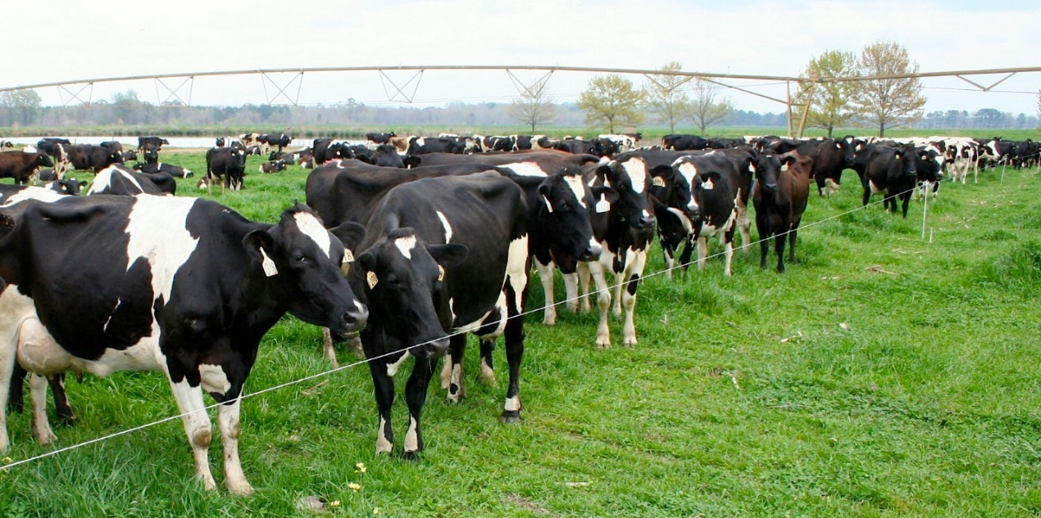
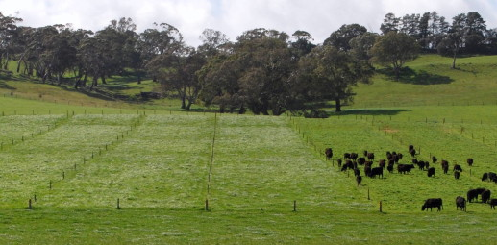
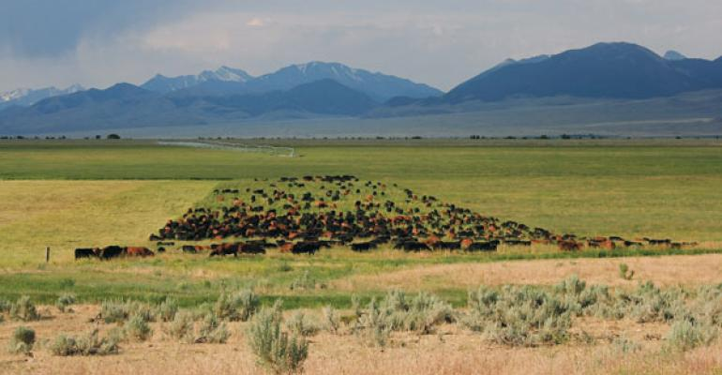
Grazing management for soil health
Small paddocks
Need at least 28 areas
High stocking density
Trample and eat unambiguously
Short Duration
<3 days so they don’t eat new growth

Slide 18
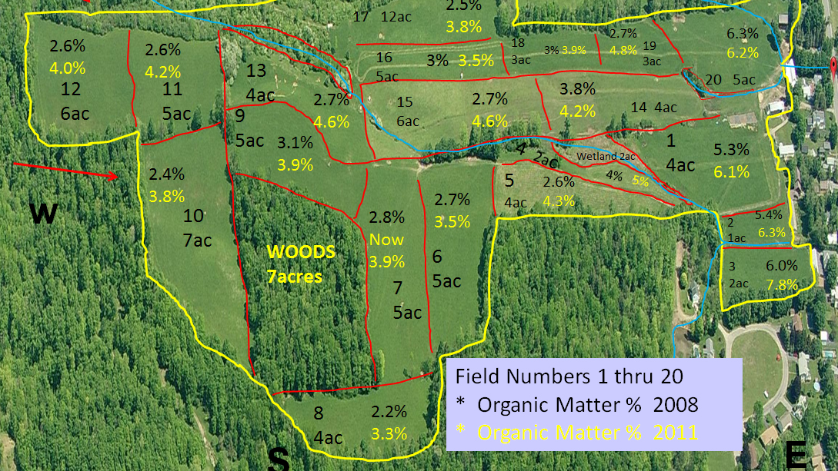
OM has increased in every single pasture
Notes:
Troy Bishop

Slide 19
System Benefits Tangible Benefits
Increased soil carbon
Higher plant productivity
Greater water infiltration
Greater water holding capacity
Higher rate of nutrient cycling
Decreased soil loss
More months of grazing
Higher stocking rate
Lower weed pressure
Decreased disease pressure
Drought resilience
Higher profits

Slide 20
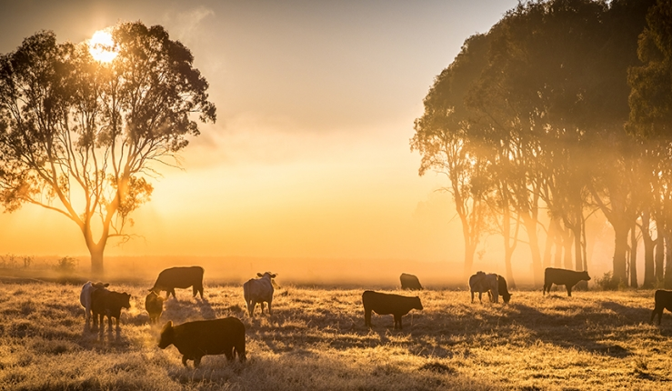
Grazing is Key to our Future
Soil is the base of your system
Feed your microbial herd
Roots rely on recovery
Increasing Soil Carbon will save you time, money, and the environment

Slide 21
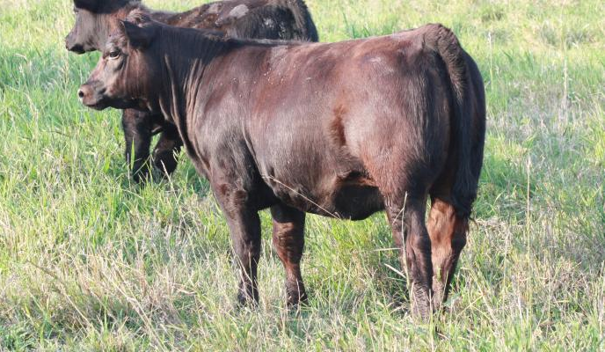
Questions? Comments?
Shannon Cappellazzi
scappellazzi@soilhealthinstitute.org
503-593-7434

Slide 22
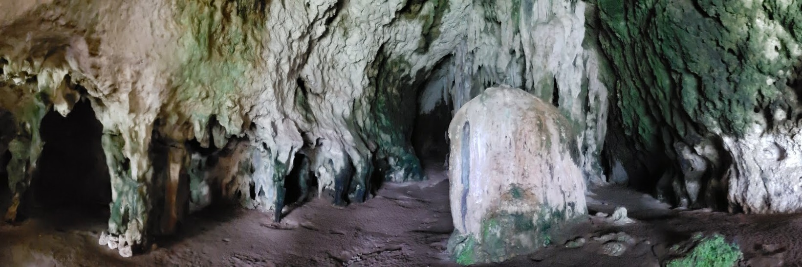
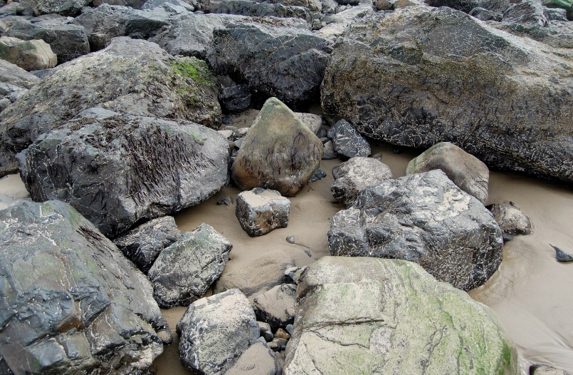
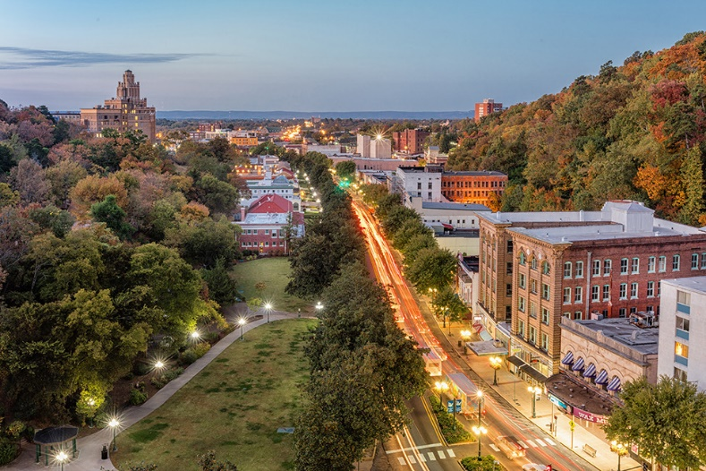
A MICROBES VIEW
Notes:
While it is impossible to summarize all of the data. I want to try to paint a picture of the microbial world.
I sometimes like to try to image what the world would look like if I were a microbe. I see a cave coated with organisms and I think of a pore space with large opening and coated with various groups of other organisms. Or maybe these rocks are like sand grains and the sand is like clay, where does the OM get trapped and growth occur and rocks to break down.
And when I try to image the microscopic habitat, I like to think of a self sufficient town. What are the jobs that each of the people in that town have? What buildings, infrastructure, and machines are needed to keep that town running? In this town this main road might be a root hair with products moving up and down and organisms set up their homes and businesses along this major route. Maybe there is a bar where people get together to eat, drink, talk, and find a partner to mate with. Maybe there are several a waste disposal services that take out the trash, recycle useable materials, and filter water. How about a communications expert, a mail delivery service, a way to generate energy, roads, scaffolding, food processing, and even some open spaces. It is that whole idea of a tiny universe, where our whole world could be just the eye of a giant. For a microbe, their whole world might be in one soil aggregate and they need to take care of all of those same services to maintain a well functioning habitat. A habitat provides food, water, structure, reproduction options, communication, transportation, goods and services, and a mutually beneficial place for simple organisms to share their abilities with the complex community around them.
As we dive deeper into soil health and how the biological community controls the all of the functions of soil we also see the tiny scale at which these are taking place. I can be hard to image

Slide 23
Negative soil health effects from grazing
Evidence | Result | Reason
Poor vegetation | No feed | Grazing at wrong intervals
Weed dominance | Decreased intake and ADG | Selective species grazing
Hard to shovel wet | Compaction | Animals on at wrong time
Smells bad | Anaerobic gas production | Crushed pore space + Nitrogen
Gray color | Slow nutrient cycling | Anaerobic environ -> Fe reduction
Ponding | Less grazing land | Drainage issues
Dusty | Soil loss | Lack of rain or OM to hold water
Chlorosis | Poor plant growth | Low N or other photosynthesis limiting nutrient

Slide 24
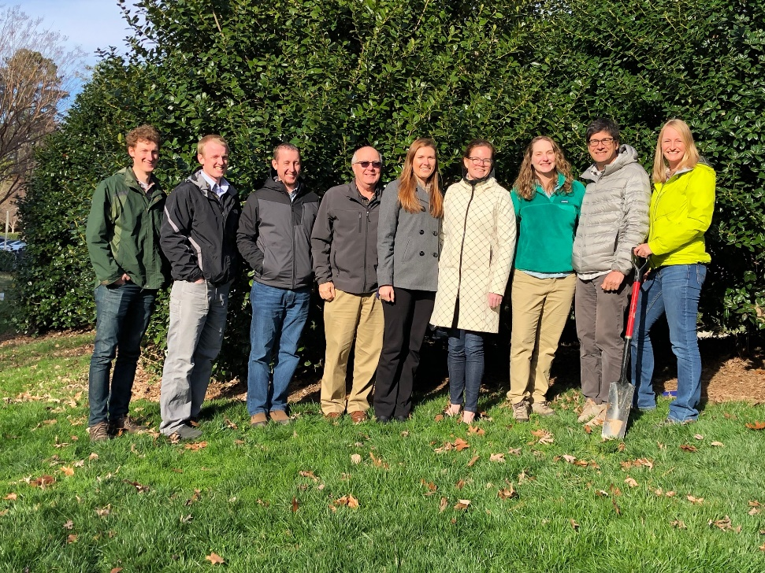

NORTH AMERICAN PROJECT TO EVALUATE SOIL HEALTH MEASUREMENTS
2000 Experimental Units
120 Long-Term Sites
Management History
Yield and Economics
31 Measurements
16S, ITS, and Shotgun Metagenomics Sequenced
SMAF, CASH, and Haney Systems Compared

Slide 26
NORTH AMERICAN PROJECT TO EVALUATE SOIL HEALTH MEASUREMENTS
2000 Experimental Units
120 Long-Term Sites
Management History
Yield and Economics
31 Measurements
16S, ITS, and Shotgun Metagenomics Sequenced
SMAF, CASH, and Haney Systems Compared
Notes:
Right now one of the biggest research projects is NAPESHM which is also the focus of our measurements and standards program. It is important as we work to transform the agricultural industry to focusing on the impact of the biology in the soil, that the disparate groups working on soil health use similar language to communicate clearly and similar testing protocols that can be interpreted so that we have a framework to build coherent recommendation and policies, that are nationally relevant and locally applicable.
2000 Experimental Units Sampled
120 Long-Term Sites Participating
Complete Management History Gathered
Yield and Economics Analyzed
>30 Measurements Tested
16S, ITS, and Shotgun Metagenomics Sequenced
SMAF, CASH, and Haney Systems Compared
Incredible dataset from which we will have the statistical power to say something meaningful about the relationships

Slide 27
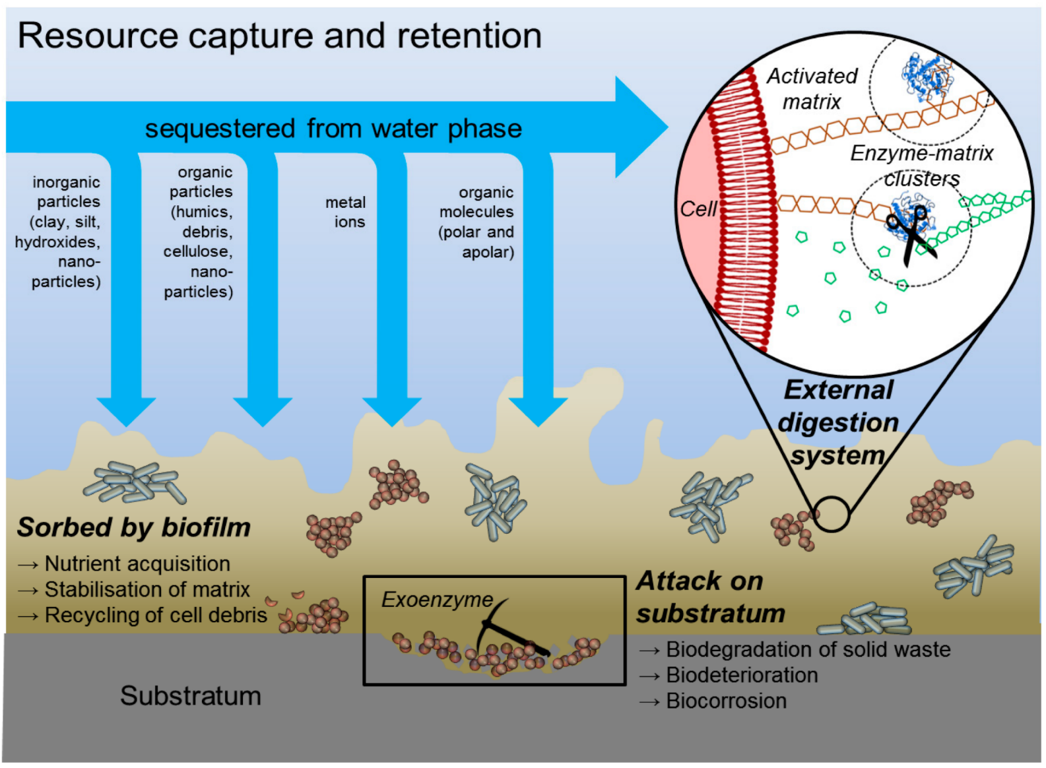
Functions rely on biofilm - EPS
Water storage +filtration
Nutrient retention
Nutrient acquisition
Nutrient cycling
Aggregate building
Gas cycling

Slide 28
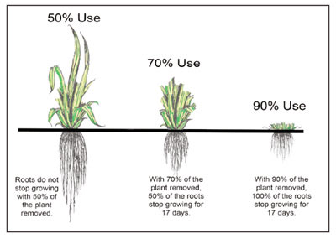
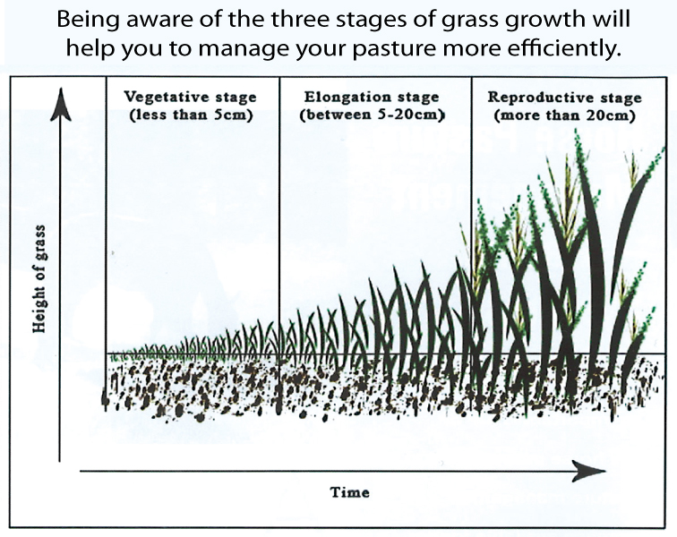
Poor vegetation => Grazing wrong time
Comprehensive grazing report Machachek, 2012
Grasses do not go back into vegetative growth if grazed during reproductive phase
Leaves are more palatable than stems
New growth or regrowth is more nutritious than older tissue
Animals will select fresh growth
Challenging in our spring
Feedback for nutrient acquisition

Slide 29
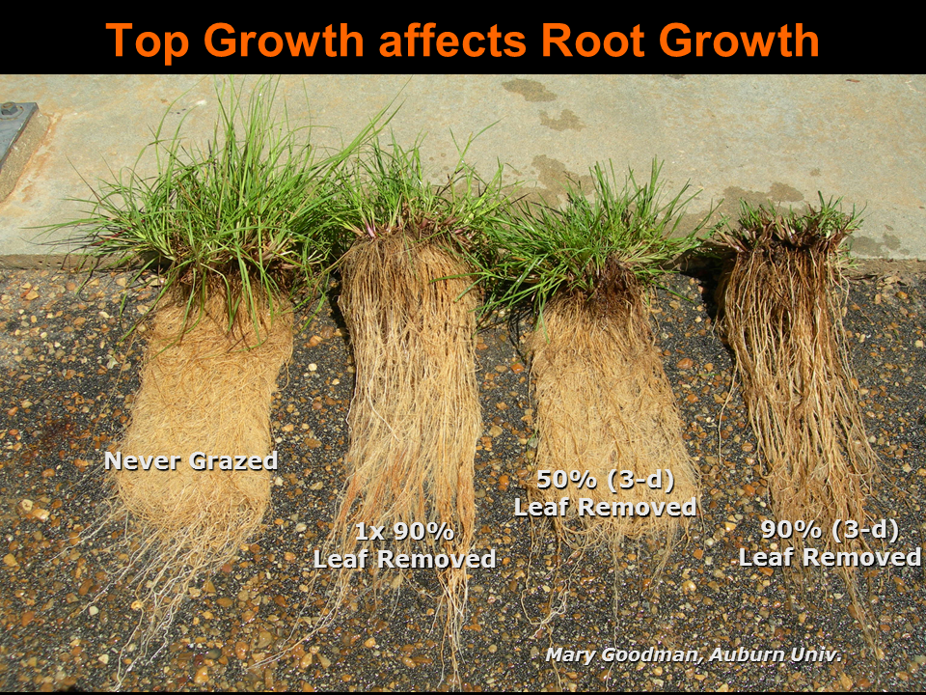
Poor vegetation => Little time for regrowth
As forage is eaten, the C captured by photosynthesis is decreased
Less energy to root zone
Less root to get water and nutrients
Slower regrowth
Fewer plant C inputs
Microbial community activity decrease
Animals will choose to eat fresh
Continues cycle of less root biomass
Never Grazed
90% 21 day recovery
50% 3 day recovery
90% 3 day recovery

Slide 30
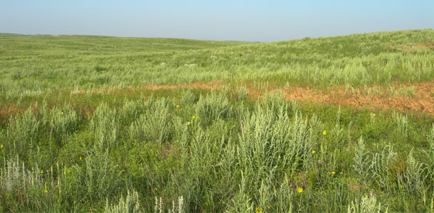
Weed dominance => Decreased intake and ADG Selective species grazing
Animals will choose to graze their favorites
Will come back to get the freshest new growth
Destroys photosynthetic capability
Destroys root system of favored species
Diminishes SOM and root microbial interactions
Favorite species can not compete with less palatable
Weeds take over
Fewer digestible nutrients
Poor animal performance
Supplement with other feed
Notes:
Lambsquarters

Slide 31
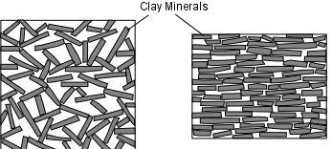

Compaction => Animals on at wrong time
Compaction impacts the habitat space (pores), and food and water availability
Compaction leads to
slow water infiltration
ponding
surface runoff
reduced beneficial microbial habitat
anaerobic conditions
poor root growth
nutrient deficiencies
All of those result in reduced function
Effect of soil compaction on root growth at three different soil bulk densities: Low, 0.7 g/cm3; Medium, 1.1 g/cm3; High, 1.6 g/cm3

Slide 32


Anaerobic conditions=> Compaction = Crushed pore space
When compaction has crushed the pore spaces there is not much oxygen for use as terminal electron acceptor
Microbes use alternatives NO₃, Mn, Fe, S
If N is available, preferred, will produce high levels of N₂O
By products smell bad
Slower nutrient cycling
Plant roots can’t exchange gasses
Poor plant performance
Feedback loops for decreased soil health

Slide 33

Dusty => Lack of water
Without plant cover soils get warm
Warm soils higher rate of evaporation
Without water soil organisms go dormant
Without plants C doesn’t enter system
Without C microbes cant glue or cycle nutrients
Without aggregates and SOM soil can not hold much water
Without SOM, water, and cover, particles blow in the wind -lost
Feedback loops of desertification

Slide 34


Ponding => Drainage issues Less grazing land
Drainage can be caused by inherent soil characteristics
High levels of clay below surface – slow water infiltration
Capillary barrier – sudden change in texture – no matric pressure to move water
Shallow depth to bedrock – no where for the water to go
Topography that funnels all water to one area
Exacerbated by compaction and lack of aggregate stability and organic matter
Both lead to slow infiltration
Both decrease total water that can be held in soil

Slide 35

Chlorosis =>Poor plant growth Low N or other photosynthesis limiting nutrient
Yellow plants mean not enough chlorophyll performing photosynthesis
N is the most rate limiting nutrient – first assumption
Dark green patches small areas of adequate nutrition
Uneven distribution of nutrients
Decreased forage production
Decrease microbial functioning

Slide 36
Medium for plant growth
Recycling nutrients = decomposition
6 functions of soil
Modifier of atmosphere
SOIL
Habitat for organisms
Water supply and purification
Engineering medium

