Slide 1
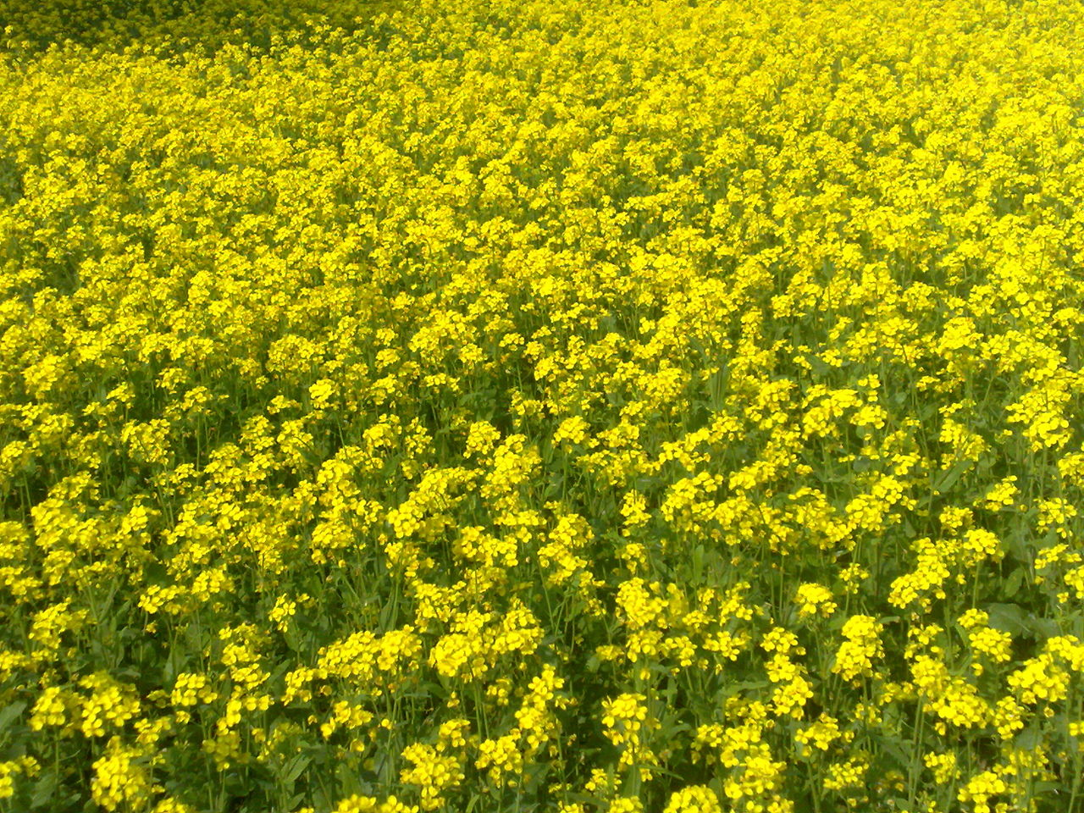

Nitrogen Concentration and Nitrogen Mineralization by Nonleguminous cover crops: Applications to central Oregon cropping systems
Joshua Neuman
Crop and Soil Science Department
Notes:
Must be in Slide Master mode to swap out photos.

Slide 2
Overview
Presentation focused on lab incubation of nonleguminous cover crops
Original intent was to get Nitrogen (N) mineralization from cover crop and subsequent cash crop N uptake data
Field experiment failed and its results will not be discussed

Slide 3
Place of Nonleguminous Cover Crops In Central Oregon
Central Oregon growers are starting to use nonleguminous late-summer planted cover crops, especially brassicas
These covers provide several agroecosystem services:
Erosion control (and weed suppression)
Improved soil structure/water infiltration
Crop rotation (reducing pathogen load by breaking monoculture)
Biofumigation (from brassicas with high glucosinolate levels)
Nitrogen (N) “catch crop”
Notes:
Brassicas and small grains are good N catch crops because of their deep and laterally-extensive root systems
Use of overwintering small grains and brassicas to recycle residual soil N to a subsequent spring cash crop is of primary interest to growers

Slide 4
Brassica vs Small Grain Covers
Forage radish (Raphanus sativus) can root to 2.5 m and take up substantial amounts of N
N scavenging and resupply in Fall-planted forage radish 162 kg/ha (Thorup-Kristensen 2006)
Brassicas are the fastest-growing cover crops
Accumulate up to 8,000 lb/ac. biomass and achieve 80% ground cover (Chen et al., 2012)
Fall small grain cover crops retain more N than Fall brassicas if the brassica is planted too late (Voss and van der Putten, 1997)
Notes:
Emphasize how rapid brassica growth enables high amounts of N uptake.
Brassica growth and N uptake are highly dependent on planting date.
If they are planted too late, they will not accumulate as much N as a Fall small grain cover crop.
Another way that brassica cover crops reduce N concentrations in the soil profile is through transpiration– large transpiration rates from dense stands of Fall brassicas will pull N up in soil solution into plant, decreasing N concentrations in the soil (Weinert, 2002)
Use of overwintering small grains and brassicas to recycle residual soil N to a subsequent spring cash crop is of primary interest to growers

Slide 5
Brassicas: Nitrogen Suction Pumps
Brassicas have relatively low C:N ratios, similar to legumes, on the order of 37-41 g/kg N shoot dry weight (Brennan et al., 2013)
This makes decomposition and N release more rapid than any other non-leguminous cover crop
Critical N concentration for net N mineralization from cover crop dry matter is generally 14-18 g/kg N
Following high residual N crop (e.g. potato) can accumulate and recycle a lot of N
Reduced fertilizer N cost
Notes:
On field following high N residue crop, e.g. potato, can recycle a lot of N and reduce fertilizer costs

Slide 6
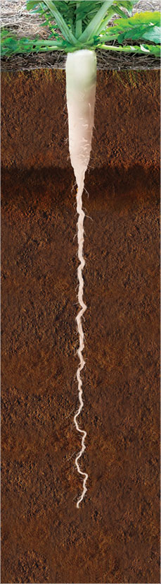
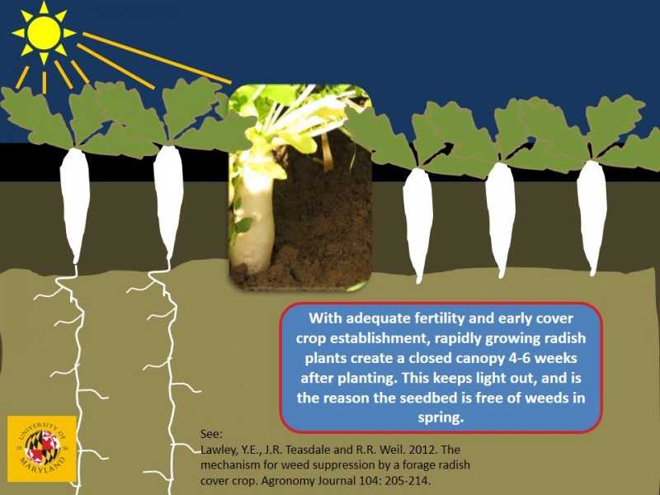
30” (76 cm) taproot
Notes:
30” taproot

Slide 7
Nitrogen Resupply Knowledge Gaps
Growers want to know three things about the N dynamics of nonleguminous cover crops:
How much N is needed to establish an overwintering nonleguminous cover crop?
How much N will the cover crop return to a subsequent spring cash crop?
When will that N be released from tillage-incorporated cover crop residues?

Slide 8
Synchrony: the Key to Coordinating N Return to Crops
Synchrony: temporal coordination of N mineralization from decomposing cover crop residues with cash crop N needs
Previous research has found brassica N mineralization to reach levels of 75% N release within 5 weeks (Brennan et al., 2013, Vos and Van der Putten, 2001, Weinert et al., 2002)
Notes:
Synchrony is the single most important consideration when cover crops are intended to be used to recycle N!
Even though synchrony was not explicitly studied in-field in my research, it is the most crucial consideration in deciding whether a certain cover crop is desirable for recycling N and also determining tillage date vis-à-vis wheat planting.
This must be the focus of further research.

Slide 9
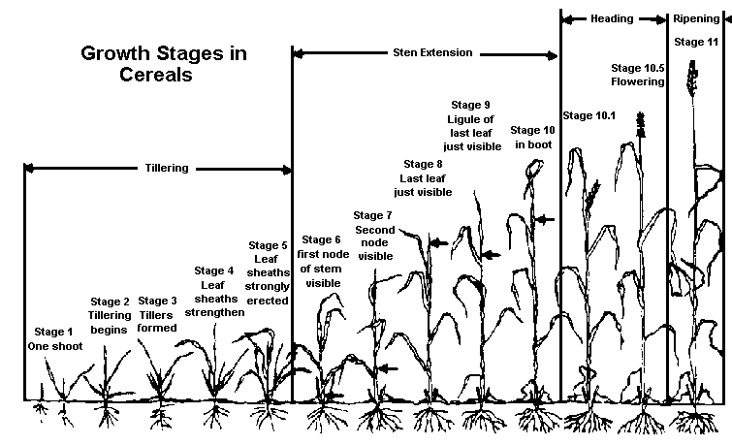
http://corn.agronomy.wisc.edu/Crops/Wheat/L007.aspx
Period of N uptake: Feekes 6-10

Slide 10
Hypotheses of Research Project
Nitrogen concentration in young mustard, radish, and oat cover crop residues is a function of N fertilization rate.
Nitrogen mineralization is a function of N concentration in young mustard, radish, and oat cover crop residues.
Nitrogen mineralized at room temperature will be highest at 4 weeks of incubation and by the 8th week, there will be little N release from young mustard, radish, and oat cover crop residues.
Notes:
N fertilization rate can stand in as a proxy for residual soil N from a prior cash crop.
The higher the N concentration in a residue the higher the amount of N mineralized and the faster the rate of N mineralization.

Slide 11
Objectives
Field experiment
Observe the effect of different N rates and cover crop species on yield and protein content of wheat at harvest
Laboratory experiment
Observe the effect of N rate on cover crop N concentration
Observe the effect of N concentration on N mineralization

Slide 12
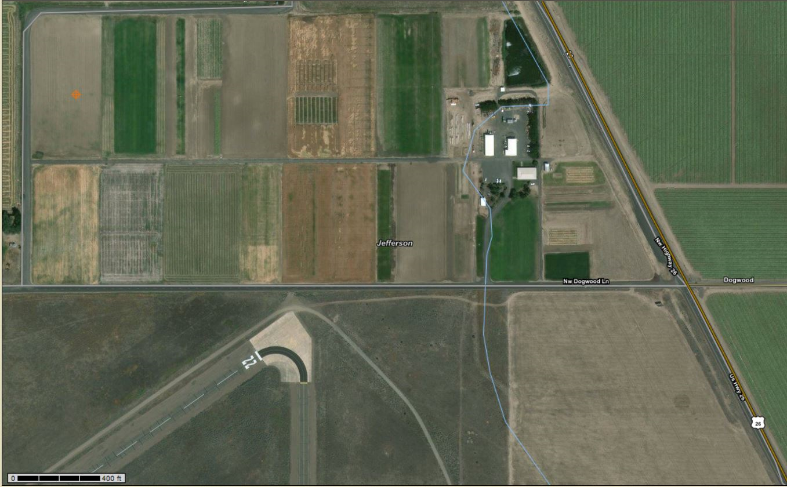
Materials and Methods: Field Trial
Experimental location: Central Oregon Agriculture Research and Extension Center (COAREC)
Soil type: Madras Loam
Previous crop: Spring wheat
Notes:
Mustard (Brassica juncea “Caliente 199”)
Forage radish (Raphanus sativus L. var oleiformis “Anaconda”)
Oats (Avena sativa “Charisma”)
Soil-only control

Slide 13
Materials and Methods: treatments
4x cover crop treatment
Mustard
Forage radish
Oats
Soil-only control
4 x N fertilizer rate
0 kg/ha
45 kg/ha
90 kg/ha
135 kg/ha

Slide 14
Materials and Methods: field setup
4x4 factorial
Randomized complete block design (RBD)
4 x replications
16 treatments x 4 replications = 64 subplots
Plot size: 16’ wide x 30’ long (4.9 x 9.1 m)
4’ (1.2 m) between plots w/in row
5’ (1.5 m) between rep rows

Slide 16
Materials and Methods: field trial
Variables measured
Soil NO₃- N and NH₄- N to 15 cm
Measurement intervals:
Pre-cover crop planting for background N
Post-cover crop for residual N not taken up/N released from decomposition of dead covers
Post-wheat harvest N
Grain head N
Data from field trial will not be shown
Notes:
6 inches is not an ideal sampling depth for studies involving wheat, where N sampling depth should be 2 ft. The nature of the soil and the equipment we had to sample made this unfeasible.
Soil N measured by KCl extraction and colorimetric reaction quantified by Lachat autoanalyzer
Grain head N measured by dry combustion

Slide 17
Materials and Methods: lab incubation
Cover crops grown in seeding trays in greenhouse
Grown 10 weeks
Fertilizer rates were identical to field but scaled to 0.2 m² tray
Plants harvested, cut at soil level and washed of soil then frozen until use in incubation experiment
Notes:
Incubation protocol followed Sullivan et al., 2011
4 wk and 8 wk measurement points at which soil sample was removed and air dried and subsequently analyzed for N by KCl extraction

Slide 18
Materials and Methods: lab incubation
Each cover crop species sample oven dried and analyzed for total N content
2 g of cover crop residue oven dried at 60ºC for 72 hr
Oven dried residue ground in plant mill
150 mg of each sample was combusted in Elementar and analyzed for total N

Slide 19
Materials and Methods: lab incubation
Cover crop residues aerobically incubated in plastic bags with field soil to determine mineralization rate
Residues chopped into 15 mm pieces for rapid decomposition
Water added on weekly basis to achieve original gravimetric water content of each bag at beginning of experiment
8 week incubation

Slide 20
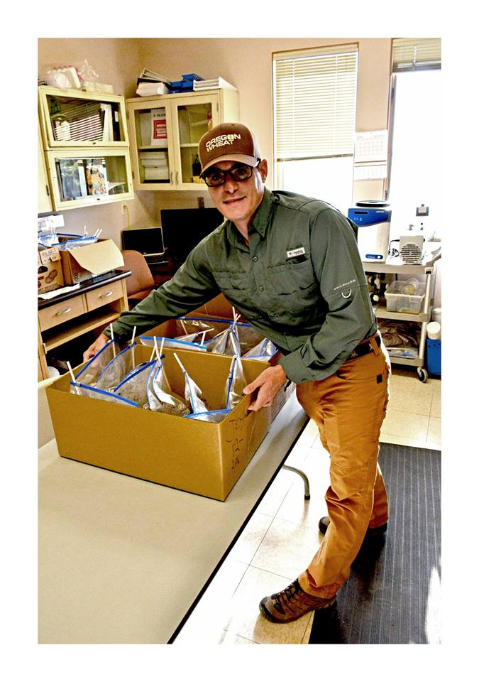

Slide 21
Results
N fertilizer rate | Mustard | Oat | Radish
Kg/ha | % N
0 | 2.54 | 2.41 | 2.24
45 | 3.29 | 3.03 | 3.07
90 | 3.67 | 3.66 | 3.40
135 | 3.81 | 4.24 | 3.90
Mean tissue N concentration as function of N fertilizer rate after 8 weeks of growth in a greenhouse setting for aboveground biomass. Plants were grown in a Madras loam soil. Four replications in a non-randomized design.

Slide 22
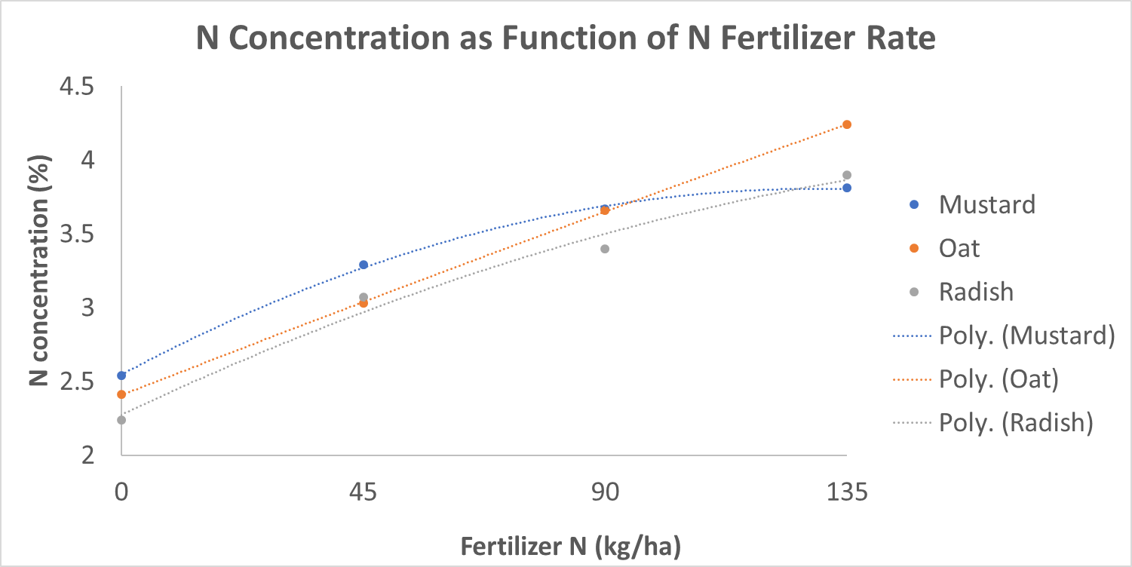
Mean tissue N concentration as function of N fertilizer rate after 10 weeks of growth in a greenhouse setting for aboveground biomass. Plants were grown in a Madras loam soil. Four replications in a non-randomized design.

Slide 23
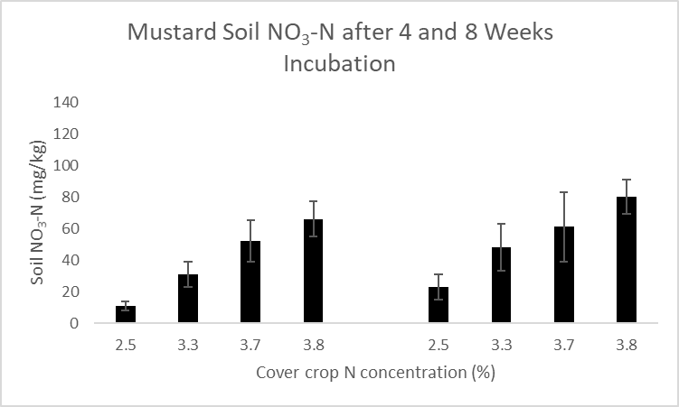
Week 4
Week 8
NO₃-N concentration in soil-only incubation bags at 4 and 8 weeks. Error bars are standard error of mean (n=4). Madras loam soil.

Slide 24
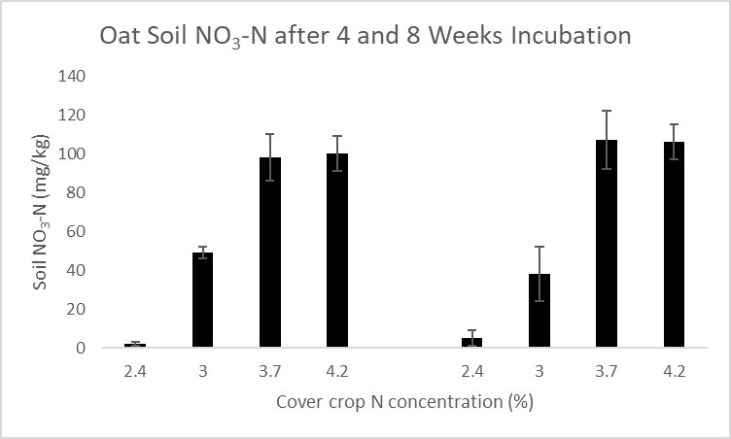
Week 4
Week 8
NO₃-N concentration in soil-only incubation bags at 4 and 8 weeks. Error bars are standard error of mean (n=4). Madras loam soil.

Slide 25
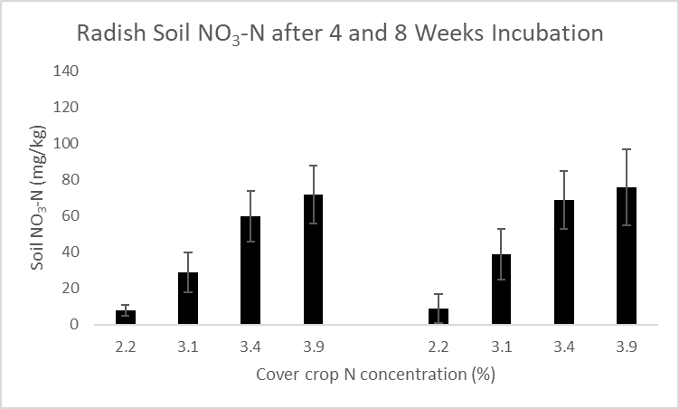
Week 4
Week 8
NO₃-N concentration in soil-only incubation bags at 4 and 8 weeks. Error bars are standard error of mean (n=4). Madras loam soil.

Slide 26
Discussion
NO₃-N mineralization over the 8-week period ranged from 46-245 kg ha⁻¹ for all cover crops
%N levels ~4% to release large amounts of N (Sullivan, not yet published)
Need either residual soil N or fertilizer rates of 90 or 135 kg ha⁻¹ to get these concentrations based on results of experiment
At phenological stage of small grain termination in this experiment, not a lot of N return
1 ton ac⁻¹ dry matter at pre-jointing vs. 10 ton ac⁻¹ at maturity
12 lb ac⁻¹ N vs. 120 lb ac⁻¹ N at pre-jointing vs. at maturity
Notes:
NO3-N mineralization numbers for all fertility levels from 0-135 kg/ha
Need 4% N to get 36 lbs N/ dry ton at 4 WK and 40 at 10 weeks (“Predicting PAN with the OSU Organic Fertilizer and Cover Crop Calculator)
At this growth stage, oat would only return 12 lb N/ ac; based on wheat from Sullivan studies in Willamette Valley
Generally not economically feasible to fertilize a cover crop at levels this study showed to result in significant N return; therefore only plant brassicas as N catch crops after a high residual N Cash crop, such as potato

Slide 27
Conclusion
Increasing N fertilizer rates increased % N in cover crop residues
90 and 135 kg N ha⁻¹ fertilizer rates produced cover crops with the highest % N and greatest N mineralization
Similar levels of mineralization seen at 4 and 8 weeks
Two-month N mineralization window extends availability of cover crop N to subsequent cash crop
Notes:
A two-month mineralization window extends the availability of cover crop-derived N to a subsequent cash crop, increasing the ability to achieve synchrony and meet crop N demands over a wider time period and even provide some N to a winter crop.

Slide 28
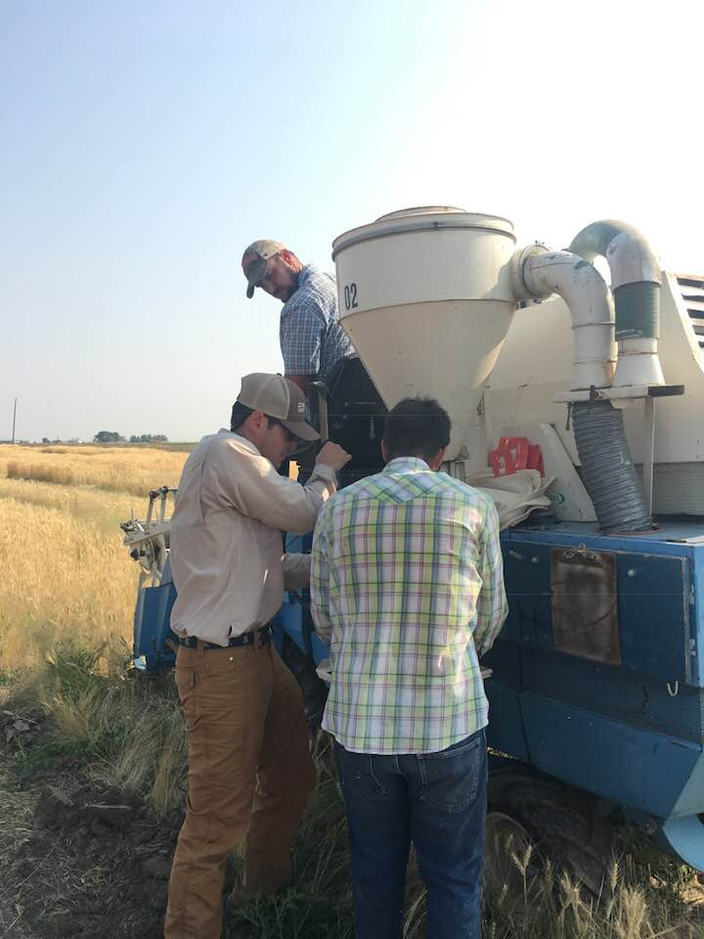

Slide 29
Acknowledgments
My committee: Markus Kleber, Amber Moore (Crop and Soil Science) and Chris Mundt (Botany and Plant Pathology) for providing editorial advice
Russ Karrow, administrator of the Agricultural Research Fund, for providing the funding for this project
Clara Weidman and Eliza Smith for helping me with graphs and tables and formatting of Masters Project Report

