Slide 1
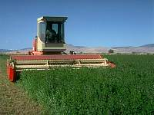
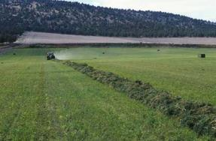
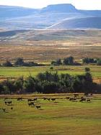
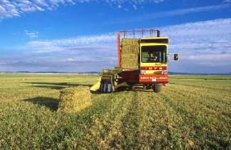
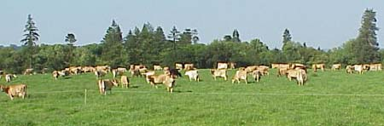
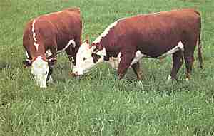




International Forage & Grasslands Curriculum
Forage-related Animal Disorders
David Hannaway Kimberly Japhet
Forage Specialist Online Instructor Crop & Soil Science Department
Oregon State University
Shelby Filley
Livestock & Forage Specialist
Animal & Range Sciences Dept.
Oregon State University
Adapted from the (US) National Forage & Grassland Curriculum
http://forages.oregonstate.edu/nfgc
Primary Source: Forages: An Introduction to Grassland Agriculture Ch. 18

Slide 2
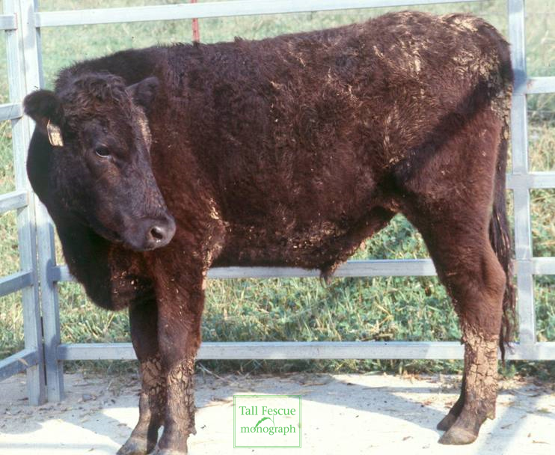
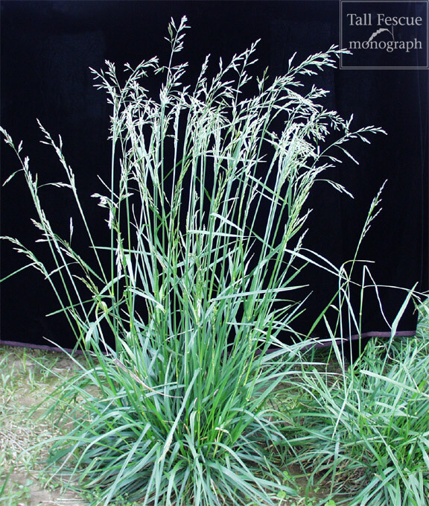
Overview
Purpose: to help students understand causes of forage-related animal disorders and management practices that can be used to avoid or ameliorate.

Slide 3
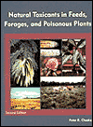
Overview of Chapter 18 – pp. 415-441
What are anti-quality constituents?
Poisonous plant disorders
Seasonal and conditional disorders
Grass tetany
Bloat
Nitrate toxicity
Prussic acid poisioning
Species-related disorders
Tall fescue toxicosis
Ryegrass staggers
Tannin and other phenolics
Stored forage disorders
Summary
Peter Cheeke’s book
Livestock sometimes experience negative consequences from naturally occurring plant toxins or imbalances of plant nutrients. Managers must be aware of these factors to avoid problems.

Slide 4
Instructional Objectives
Define and list examples of anti-quality constituents.
List and describe the main groups of forage-related disorders.
List examples of poisonous plants found on grasslands.
List and describe the main seasonal disorders occurring with forage plants.
List and describe forage-related disorders related to fertility management and weather conditions.
Describe causative factors and management to minimize risk of forage-related animal disorders.

Slide 5
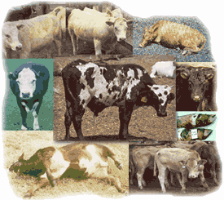
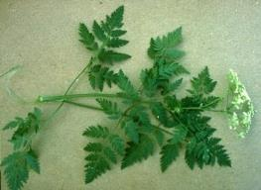
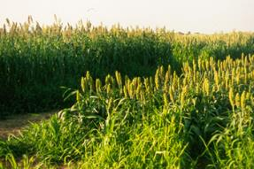
What are anti-quality constituents?
“Chemical compounds that have negative effects on forage intake or produce negative responses in animals consuming the forage.”
Some toxic compounds occur naturally
Others result from insect infestations
Some from microbial activity
Three main groups:
Poisonous plants
Seasonal or conditional disorders
Species related disorders
Poison hemlock
Sorghum-sudangrass
http://stephenville.tamu.edu/~butler/foragesoftexas/animaldisorders/animaldisorders.html

Slide 6
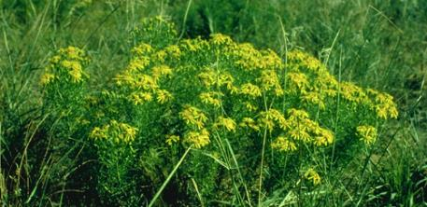
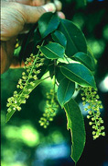
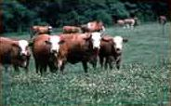
Poisonous plant disorders
Poisonous plants contain some toxic compound that is harmful to livestock, either chronic or acute.
Example poisonous plants:
common groundsel
poison hemlock
tansy ragwort
black cherry, chokecherry
nightshade
Tansy ragwort
Herbivores tend to select nutritionally superior diets and have some ability to avoid toxins. More problems occur under conditions of overgrazing.
Chokecherry
University of Pennsylvania Poisonous Plants Web Segment http://cal.nbc.upenn.edu/poison/Default.htm

Slide 7
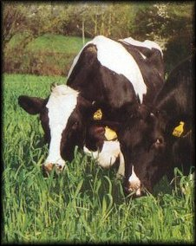
Seasonal and conditional disorders …
… occur only under certain environmental conditions, at certain plant growth stages, or susceptible animal stages.
Example disorders:
grass tetany (hypomagnesemia)
bloat
nitrate toxicity
prussic acid (HCN) poisoning
phytoestrogens
photosensitization

Slide 8
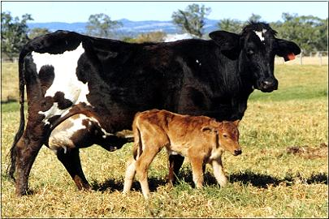
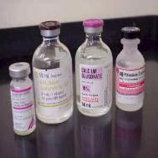
Grass tetany (hypomagnesemia) …
… metabolic disorder characterized by low blood serum magnesium levels.
Occurs most frequently in spring when temperatures rise into the range of 40-60F encouraging a rapid flush of grass growth:
Mg concentration in forage is < 0.20% DM
K concentration is high
high rates of N fertilizer are applied
ratio of K/Ca + Mg is above 2.2 (on an equivalent basis)
Strategies for avoiding:
direct supplementation of animals with Mg
careful N and K fertilizer management
supplemental dietary energy
Treatment: Ca-Mg-gluconate solution injection

Slide 9
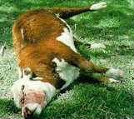
Bloat
“Legume frothy bloat occurs when a stable foam forms at the surface of the floating raft of actively digesting forage in the rumen and blocks access to the esophagus, causing gases to accumulate.”
Ruminal gas production
(0.5 gal/min in cattle, 0.2 gal/min in sheep)
Normally gas escapes through eructation
Blocked distal esophageal sphincter
Death may occur within minutes
No single causative factor:
lush stands of legumes
formation of stable foam
high levels of soluble protein
Management to reduce:
grass-legume mixtures
bloat-safe legumes (trefoils, sainfoin)
provide hay or other feed
“bloat-guard” blocks
US and Canada cattle death losses due to bloat are 0.5%
Treatment: vegetable oil or other antifoaming into rumen with 0.75-in. diameter hose.

Slide 10
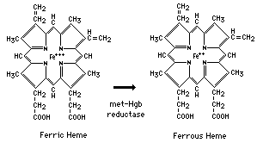
Nitrate toxicity
“… toxicity occurs when ruminants ingest nitrate in excess of the ability of rumen microbes to convert the nitrite intermediate to ammonia.”
Characteristics:
nitrate is common form of N absorbed
nitrate intermediate transforms hemoglobin into methemoglobin, restricting oxygen transport
forages < 0.44% DM nitrate are safe
nitrate poisoning blood is “chocolate brown”
problems usually with grasses due to over-fertilization
drought stressed sorghums commonly high in nitrate
Treatment: remove animals to another forage source, feed energy supplement, intravenous methylene blue.

Slide 11
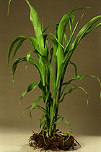
Prussic acid (HCN) poisoning
“… also referred to as hydrocyanic acid poisoning or cyanide poisoning, occurs when consuming cyanogenic glycosides.”
Characteristics:
occurs in sorghums < 18” or plants recovering from frost or drought stress
epidermal cells contain cyanogenic glucoside
mastication mixes enzymes and dhurrin leaving aglycone from which HCN is released
cyanide is absorbed through rumen wall
symptoms include rapid, then labored slow breathing, muscle spasms, dilated pupils
death occurs in 15 minutes → 2 hours from asphyxiation (inhibits cytochrome oxidase); blood color is “cherry red”
Prevention: split N applications, make hay or silage, delay grazing for 2 weeks following frost

Slide 12
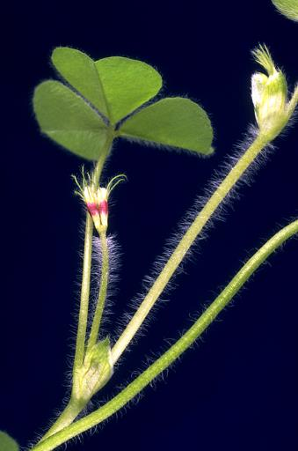

Phytoestrogens
“… naturally occurring plant phenolic compounds that mimic estrogen hormones in animals.”
Characteristics:
phytoestrogens cause infertility
(formononetin, biochanin A, and genistein)
more common in sheep than cattle
subterranean clover may have up to 5% DM
low phytoestrogen cultivars developed
red clover, white, berseem clover contain
Subclover
General structure of flavones and isoflavones.

Slide 13
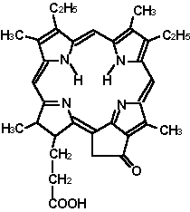
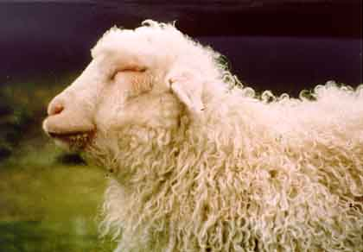
Photosensitization
… primary photosensitization occurs when compounds in the plant move directly to the skin and cause the reaction
(sunburned, reddened, or blistered)
Characteristics:
cattle, sheep, horses, and others
secondary photosensitization occurs when liver damage prevents normal metabolism (facial eczema caused by Pithomyces chartarum)
Phylloerythrin

Slide 14
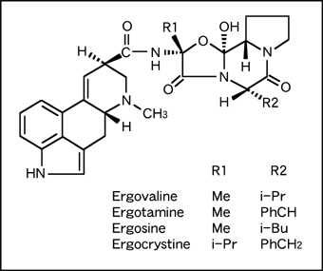
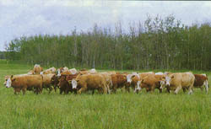
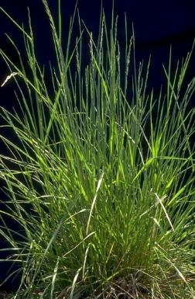
Species-related disorders
Forage species are known to contain antiquality compounds that limit animal productivity.
Example disorders:
tall fescue toxicosis
ryegrass staggers
reed canarygrass alkaloids
prussic acid (HCN) poisoning
phytoestrogens
sulfur-containing anti-quality constituents

Slide 15
Tall fescue toxicosis
“… poor weight gains and reproductive performance problems sometimes exhibited by cattle grazing tall fescue is referred to as fescue toxicosis.”
Characteristics:
tall fescue infected with a fungal endophyte
(Neotyphodium coenophialum)
fungus-plant association is symbiotic (fungal symbiont derives nutrients, plant derives increased environmental stress tolerance)
plant appearance not affected
testing required to determine infection level and toxin concentration (ergovaline the prime toxin)
symptoms: reduced intake, gain, and production, increased respiration and elevated body temperature, rough haircoat, poor reproductive performance
avoid difficulties by planting an endophyte free, forage-type tall fescue

Slide 16
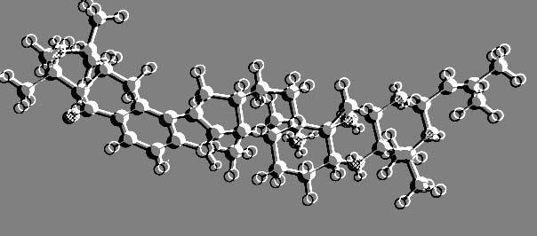
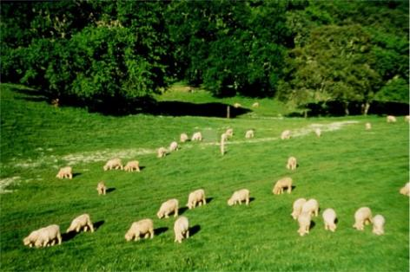
Ryegrass staggers
Some perennial ryegrass cultivars contain a fungal endophyte (Neotyphodium lolii) …
Characteristics:
Not to be confused with grass staggers (grass tetany)
Ryegrass staggers is caused by lolitrem alkaloids
Causes staggering, swaying, trembling, and collapse
Treatment involves moving affected animals to other forages and/or feeding hay or silage of some other species
Structure of lolitrem B alkaloid

Slide 17
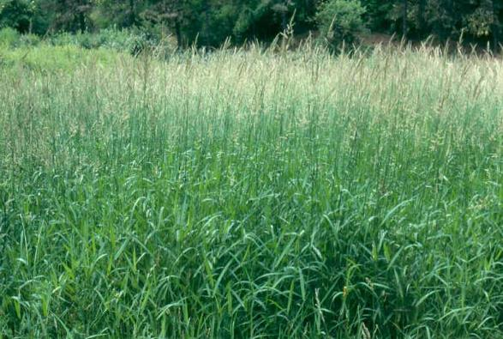
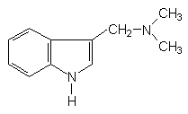
Reed canarygrass alkaloids
Some reed canarygrass cultivars contain the alkaloid gramine which can reduce forage intake.
Characteristics:
alkaloids found primarily in leaf tissue
symptoms include muscle tremors and coordination loss
low alkaloid cultivars have been developed
Indole alkaloid C₁₁H₁₄N₂
an inhibitor of acetylcholinesterase and butyrilcholinesterase
Reed canarygrass
Gramine

Slide 18
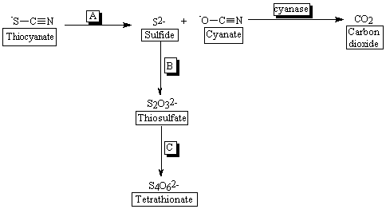
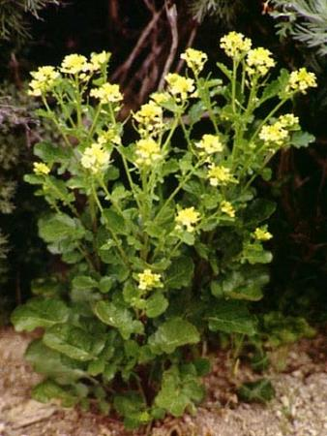
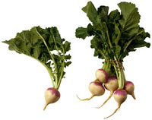
Sulfur-containing constituents
Glucosinolates and S-methyl cystein sulfoxide can negatively affect animals.
Characteristics:
Found in Brassicas
Enzymatic hydrolysis produces thiocyanate, isothiocyanate, or nitrile products
S-methylcystein sulfoxide can cause a form of anemia

Slide 19
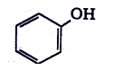

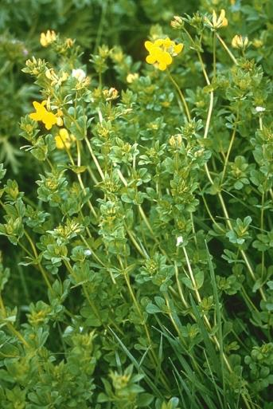
Tannin and other phenolic compounds
Compounds that contain a free hydroxyl group on an aromatic ring structure.
Examples found in plants:
amino acids tyrosine and phenylalanine
lignin
phytoestrogens
dicoumarol
Phenol
Coumarin
Negative effects of tannins:
Reduced intake
Reduced animal growth rates
Reduced fiber digestion
Beneficial effects include:
Enhanced forage protein utilization
Reduced bloat problems
Birdsfoot trefoil

Slide 20
Disorders with stored forages
In many cases, hay curing and ensiling reduces toxic compounds. Sometimes antiquality factors arise that are exclusively with stored forages.
Examples:
Botulism: Clostridium botulinum produces toxins; do not feed hay containing dead animals, ensure low pH silage
Listeriosis: Listeria monocytogenes proliferate in aerobically deteriorated or soil-containing silages; ensure low pH silage
Moldy hay and silage: mold spores and/or mycotoxins, horses highly susceptible; bale at proper moisture content, keep anaerobic
Blister beetle: beetles contain cantharidin, sometimes found in alfalfa, horses most susceptible; treat fields, check hay
Red clover slobbers: Rhizoctonia leguminicola causes black patch, alkaloids (slaframine and swainsonine) found in infected plants

Slide 21
Summary of Forage-related Disorders
Anti-quality constituents are chemical compounds that have negative effects on forage intake or produce negative responses in animals consuming the forage.
Some occur naturally, some from insect infestations, some from microbes
Three main groups: (1) poisonous plants, (2) seasonal or conditional disorders, and (3) species related disorders.
Poisonous plant problems are more severe with overgrazing
Seasonal and conditional disorders occur only under certain environmental conditions, at certain plant growth stages, or susceptible animal stages.
Examples: grass tetany (hypomagnesemia), bloat, nitrate toxicity, prussic acid (HCN) poisoning, phytoestrogens, photosensitization
Species-related disorders: some forage species are known to contain antiquality compounds that limit animal productivity.
Examples: tall fescue toxicosis, ryegrass staggers, reed canarygrass alkaloids, prussic acid (HCN) poisoning, phytoestrogens (clovers), and sulfur-containing constituents (Brassicas)

Slide 22
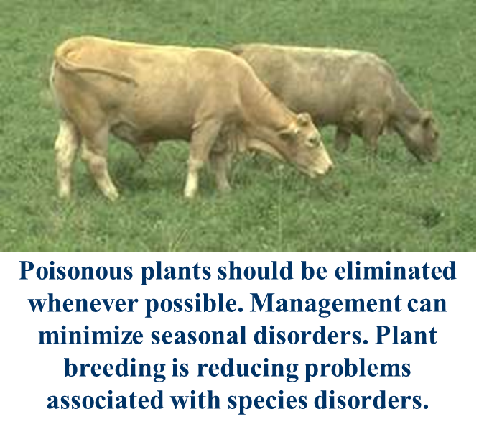
Summary of Forage-related Disorders (cont.)
Tannins and other phenolics can be positive or negative.
Although hay curing and ensiling often reduces toxic compounds, sometimes anti-quality factors may arise that are exclusively found in stored forages.
Examples include Botulism, Clostridium, Listeriosis, Moldy hay and silage, Blister beetle infestation, and Red clover slobbers

Slide 23
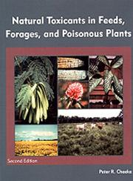
References
Publications
Cheeke, P.R. and L.r. Shull. 1985. Natural toxicants in feeds and poisonous plants. ISBN-0–87055–482–4. Avi Pub. Co., Westport, CN, USA. 492 pp.

Slide 24
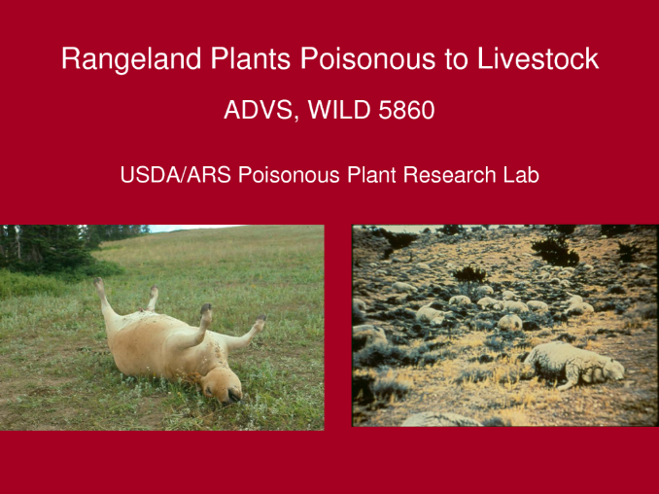
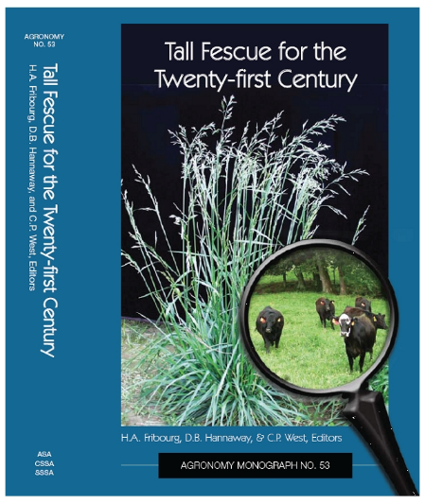
References
Websites
Rangeland plants poisonous to livestock: http://www.docstoc.com/docs/79350174/Rangeland-Plants-Poisonous-to-Livestock
Plants poisonous to livestock: http://www.ansci.cornell.edu/plants/php/plants.php?action=display&ispecies=cattle
Tall fescue toxicosis: http://forages.oregonstate.edu/tallfescuemonograph/

Slide 25
Oregon State Extension Fact Sheets
References
Avoiding Poisonous Plants in Pasture and Hay
http://extension.oregonstate.edu/douglas/sites/default/files/documents/lf/pub/applf1201.pdf
Grass Tetany
http://extension.oregonstate.edu/douglas/sites/default/files/documents/lf/tetany.pdf

