Slide 1
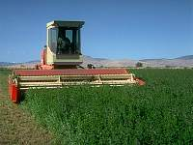
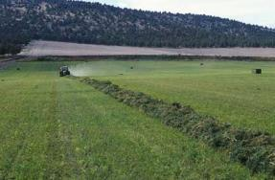
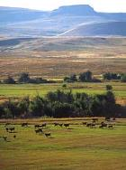
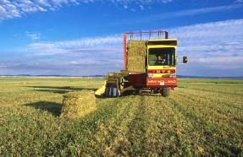
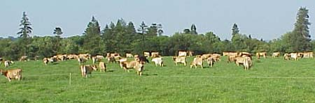
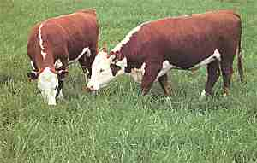




International Forage & Grasslands Curriculum
Forage Utilization
David Hannaway Kimberly Japhet
Forage Specialist Online Instructor Crop & Soil Science Department
Oregon State University
Shelby Filley
Livestock & Forage Specialist
Animal & Range Sciences Dept.
Oregon State University
Adapted from the (US) National Forage & Grassland Curriculum
http://forages.oregonstate.edu/nfgc
Primary Source:
Forages: An Introduction to Grassland Agriculture Ch. 17

Slide 2


College of Agriculture, Animal and Rangeland Sciences
Teaching
Livestock production on pastures
Forages (Crop 310)
Integrated- crop-livestock production systems.
Serkan Ates
College of Agriculture, Animal and Rangeland Sciences Department
Withycombe Hall, 208
541-740-8077
serkan.ates@oregonstate.edu
Research
Specific focus on pasture and grazing management for improved animal production and product quality
Intake, diet preference and behavior of grazing ruminants
Evaluation of new forage species and traits, including tannin containing legumes
Management of annual legumes in permanent pastures
Graduate research
Milk and Forage Production from Mixed or Spatially Separated Simple and Diverse Pastures (Lorena Carmona, MSc)
Milk Yield and Composition of Dairy Cows from Diversified Grass, Forb or Legume-based Pastures (Randi Wilson, MSc)
Lamb Growth on Hill Pastures Containing Annual and Perennial Legumes (Yunus Gultekin, MSc)
Development of Chicory Varieties with High Secondary Metabolites (Annie Seeno, PhD)

Slide 3
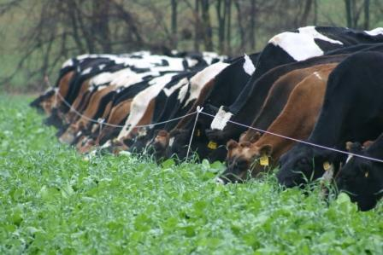
Overview
  Purpose: to help students understand the digestive anatomy of herbivores and forage-related factors affecting animal performance.

Slide 4
Instructional Objectives
Define herbivore and distinguish between ruminants and non-ruminants.
Define volatile fatty acids and give 3 examples.
List and describe factors affecting animal performance.
List and describe factors affecting fiber digestion.
Diagram how energy can be partitioned into gross, digestible, metabolizable, and net energy.
Explain the importance of the terms NEm, NEg, NEl.
List and describe factors affecting intake.
List and describe factors affecting digestibility.
Describe how grazing mechanics are different for cows, sheep and goats, and horses.
Notes:
Net Energy Gain (NEG) is a concept used in energy economics that refers to the difference between the energy expended to harvest an energy source and the amount of energy gained from that harvest.

Slide 5
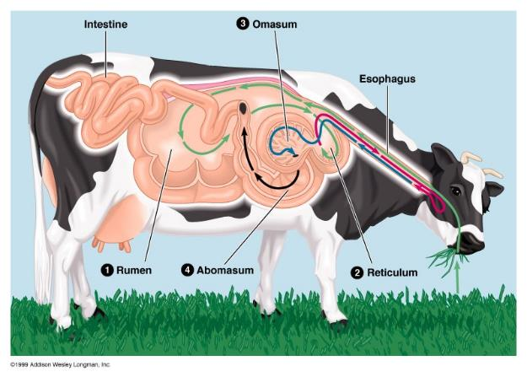
Overview of Chapter 17 – pp. 391-414
Digestive anatomy of herbivores
Factors affecting animal performance
Nitrogen nutrition
Grazing utilization
Horse nutrition differences
Dairy cattle nutrition differences
Herbivores can digest cellulose and hemicellulose to meet their energy needs. This chapter deals with animal and plant factors that influence forage consumption and digestion.

Slide 6
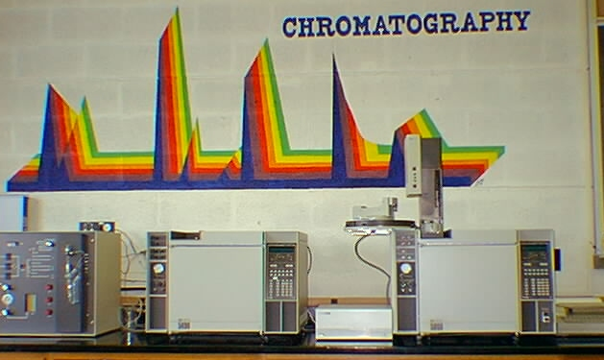
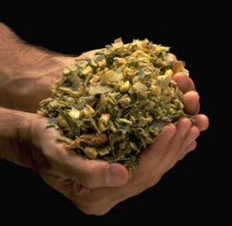
Digestive anatomy of herbivores
Digestive tract microorganisms produce enzymes (B-glycosidases) that degrade cellulose and hemicellulose.
Volatile fatty acids (VFAs) are produced:
acetic (C2)
propionic (C3)
butyric (C4)
Analysis for Volatile Fatty Acids (VFAs) is by gas chromatography.

Slide 7
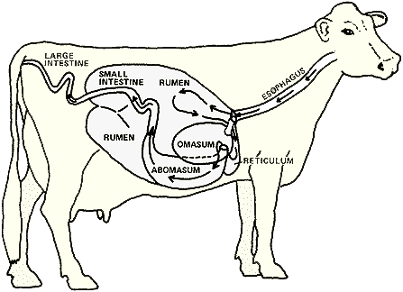
Digestive anatomy of herbivores
Ruminants (ovine and bovine species) are foregut fiber fermenters with multicompartment stomach.
Digestion occurs primarily in the reticulorumen.
Issues:
Eructation / bloat
Global warming / methane
Saliva / forage diet buffering of rumen pH

Slide 8
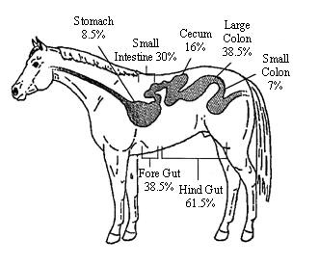
Digestive anatomy of herbivores
Non-ruminants (equids) are hindgut fermenters with an elarged cecum and colon for cell wall digestion.
Fiber digestion occurs primarily in the cecum.
Issues:
Forage quality / digestion

Slide 9
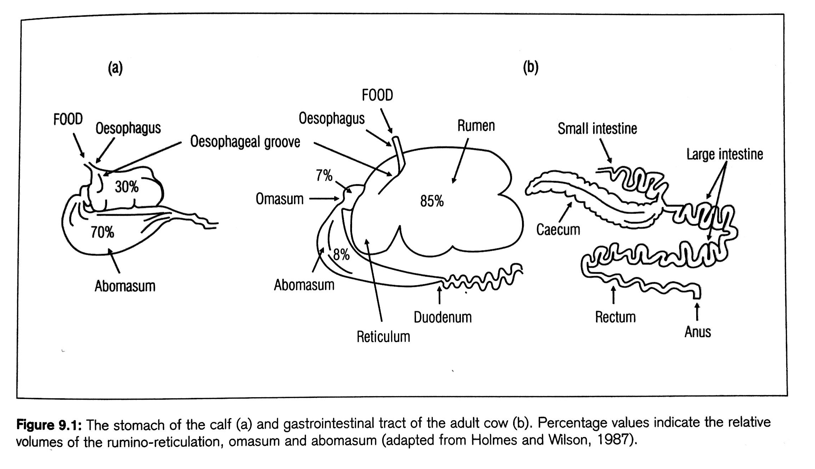
True glandular stomach
Enzymes and HLC acid secretion
Think about the role of rumen and fermentation that occurs in the rumen.
Fiber digestion starts at about 6 weeks of age.

Slide 10
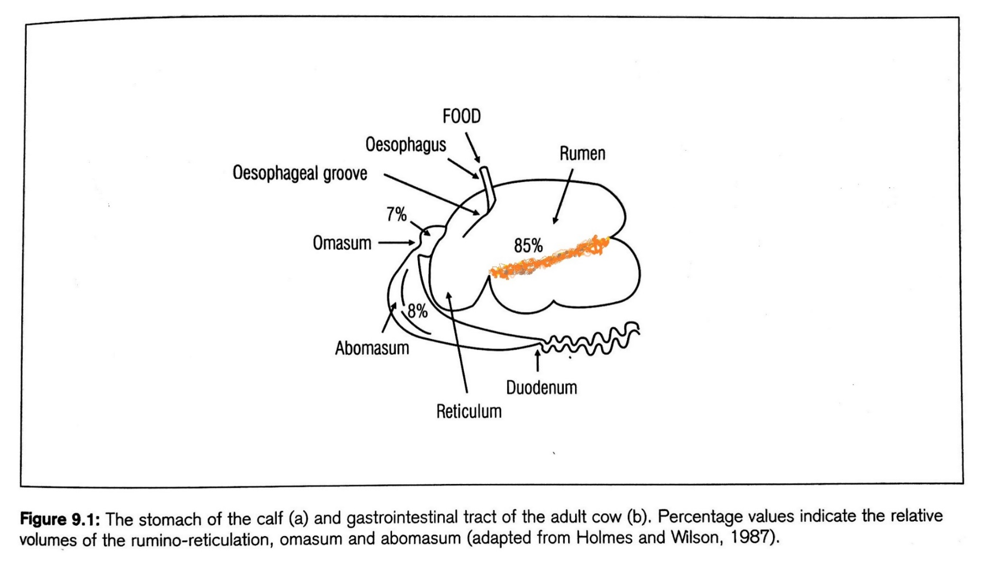
gas
fiber raft
liquids
Contains a large population of microorganisms (10¹⁰ bacteria, 10⁶ protozoa and aneorabic fungi per mm of rumen fluid.
Anaerobic environment
39 ºC and pH 6.2-7.0
https://www.youtube.com/watch?v=muf8ZA3F2mA
Notes:
Rumen directly points to reticulum which is still the part of same chamber with rumen but it has a bit of specialized role and reticulum face

Slide 11
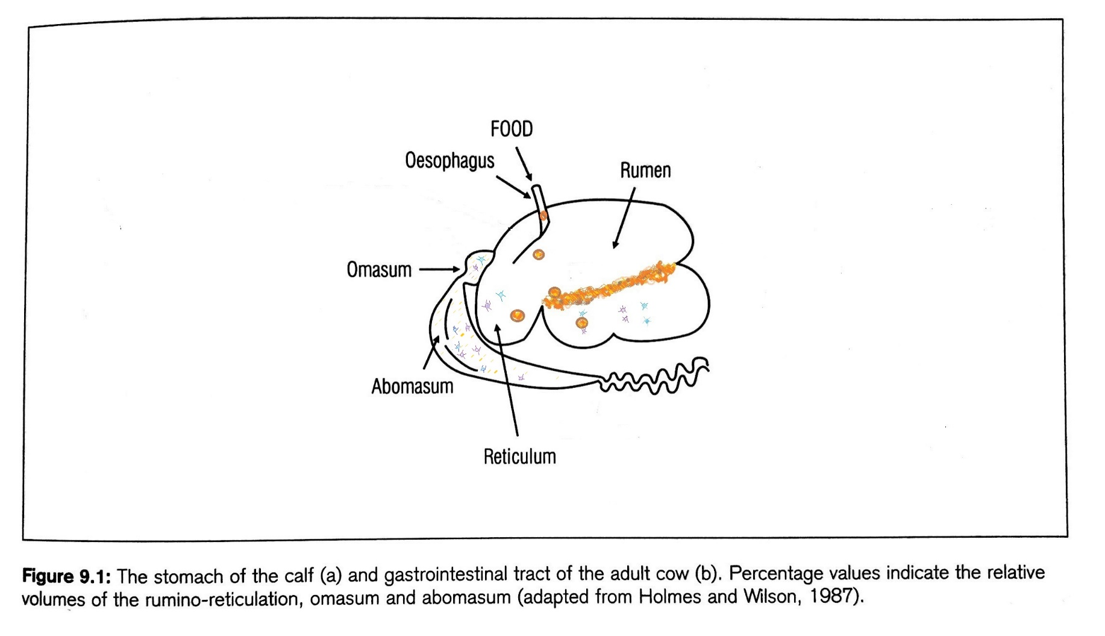
Bolus of food
VFAs, C0₂ and CH₄ --- ME
C_{n}(H₂O)_{n}
The microbial population ferments dietary nutrients including fibrous fractions that would otherwise pass undigested through digestive track.
Bacteria are responsible for fermenting carbohydrates (soluble sugars, pectin, starch and digestible fibre fractions) to simple sugars.
Notes:
Rumen directly points to reticulum which is still the part of same chamber with rumen but it has a bit of specialized role and reticulum face

Slide 12
Bolus of food
VFAs, C0₂ and CH₄ --- ME
C_{n}(H₂O)_{n}
proteins
AAs and ammonia+ simple peptides =microbial protein
pH 2-3
Converted to urea
The microbial population ferments dietary nutrients including fibrous fractions that would otherwise pass undigested through digestive track.
Bacteria are responsible for fermenting carbohydrates (soluble sugars, pectin, starch and digestible fibre fractions) to simple sugars.
Notes:
Rumen directly points to reticulum which is still the part of same chamber with rumen but it has a bit of specialized role and reticulum face

Slide 13
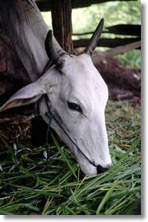
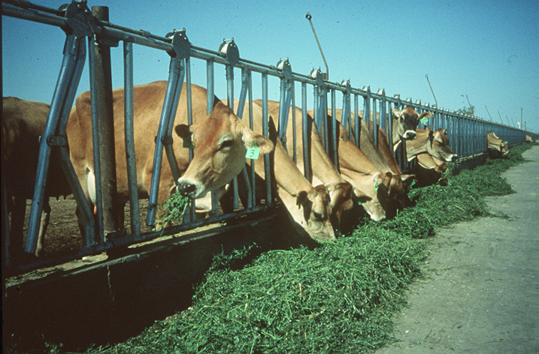
Factors affecting animal performance
Potential performance depends on:
Physiological status of the animal
Genetic makeup
Environmental effects
Forage quality; nutritive value, intake, anti-quality

Slide 14
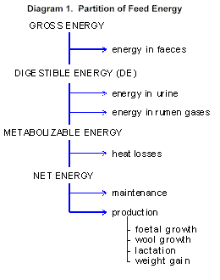
Forage digestibility
Percentage of dry matter digested:
Lignified tissues have low digestibility
Mastication and rumination increase surface area for attachment of bacteria
Partitioning of energy
  Gross energy
  Digestible energy
  Metabolizable energy
  Net energy

Slide 15
ME, DE and Nutritive Value (NV)
ME and DE are the two estimates of NV most commonly used.
ME better as expressed in quantitative units and so can be used in feed allocation to animals
ME range 8-12.5 MJ ME / kg DM (1900-3000 kcal)
Livestock will usually have high intakes of forages that have high ME content >> good representation of feeding value

Slide 16
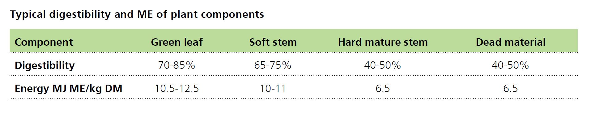
Factors affecting nutritive value
ME values MJ ME / kg DM
Pasture type
Good 12 > Medium 11 > Poor 7-10
Plant part
Green 12.5 > Dead 8-10
Upper canopy > lower canopy

Slide 17
Factors affecting nutritive value
Plant Species
Legume > Grass
11.5-13 MJ ME / kg DM 9-12.5 MJ ME / kg DM
NV of most grasses similar if plant parts are compared at the same age
exception tetraploid ryegrass

Slide 18
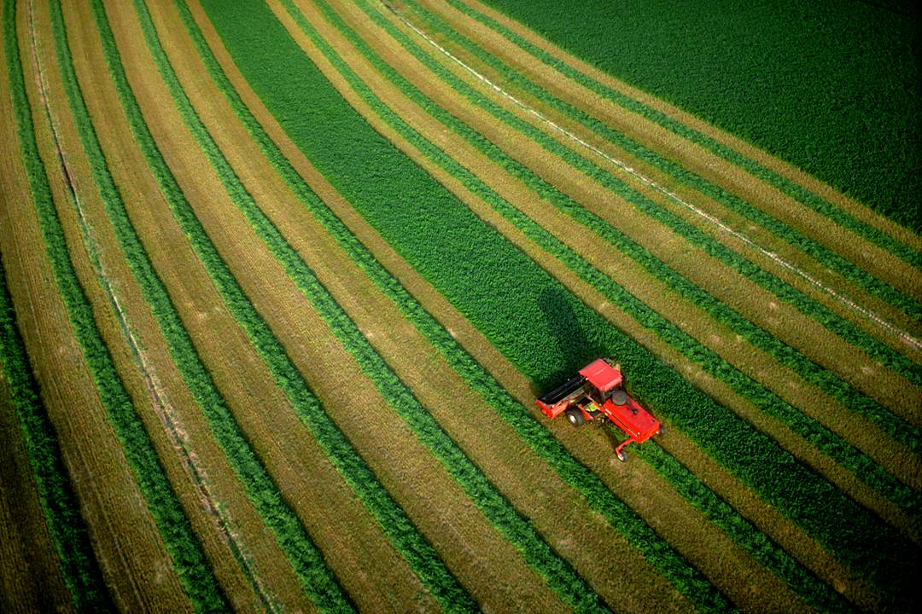
Plant Cell Wall Structure
Secondary Wall
Primary Wall
Cell
Contents
proteins
sugars
fats
starch
Hemicellulose
Lignin
NDF
ADF
Cellulose

Slide 19
Forage Quality and Animal Performance
Chemical Composition
(CP, NDF, ADF, Vit., & Minerals)
Digestibility
Forage
Nutritive
Value
Animal
Performance
Palatability
Rate of Passage
Availability
Forage
Consumed

Slide 20

Energy requirement of grazing animals
Maintenance: is required for the vital process of circulation, excretion, respiration and muscular activity.
Defined as the state in which animal is neither gaining nor losing live weight and is not pregnant or lactating.
Varies according to liveweight.
Males +15% due to faster turnover rate of leaner body mass
Lactating females +10% to maintain the function of udders
Activity +10-20% walking and grazing
Climate: +20% cold, wet and windy +50% after shearing

Slide 21
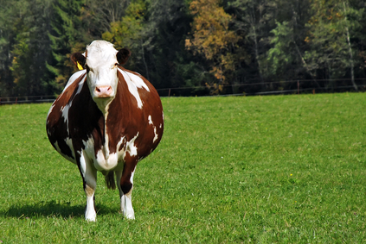
Energy requirement of grazing animals
Pregnancy: Negligible until the last third of the pregnancy and proportional to size and number of offspring.
The total cost of pregnancy above maintenance
250 MJ ME for sheep +single lamb
400 MJ ME for sheep + twin lambs
2200 MJ ME for dairy cows

Slide 22
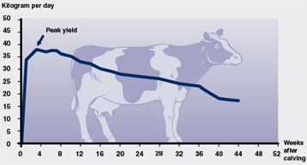
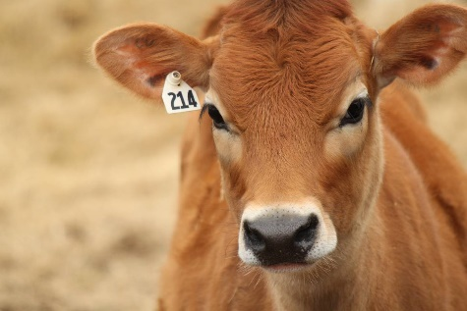
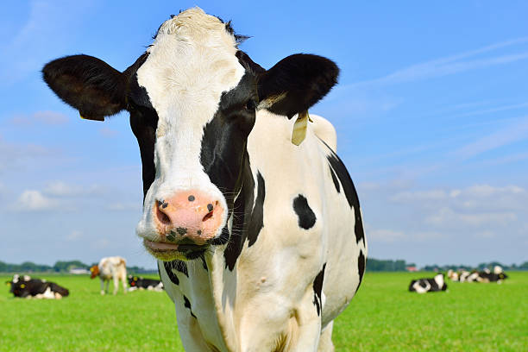
Energy requirement of grazing animals
Lactation: Varies depending on the milk yield and composition.
These costs are:
6.2 MJ ME per liter for Jersey cows
5.4 MJ ME per liter for Friesian cows
7.5 MJ ME per liter for lactating ewes

Slide 23
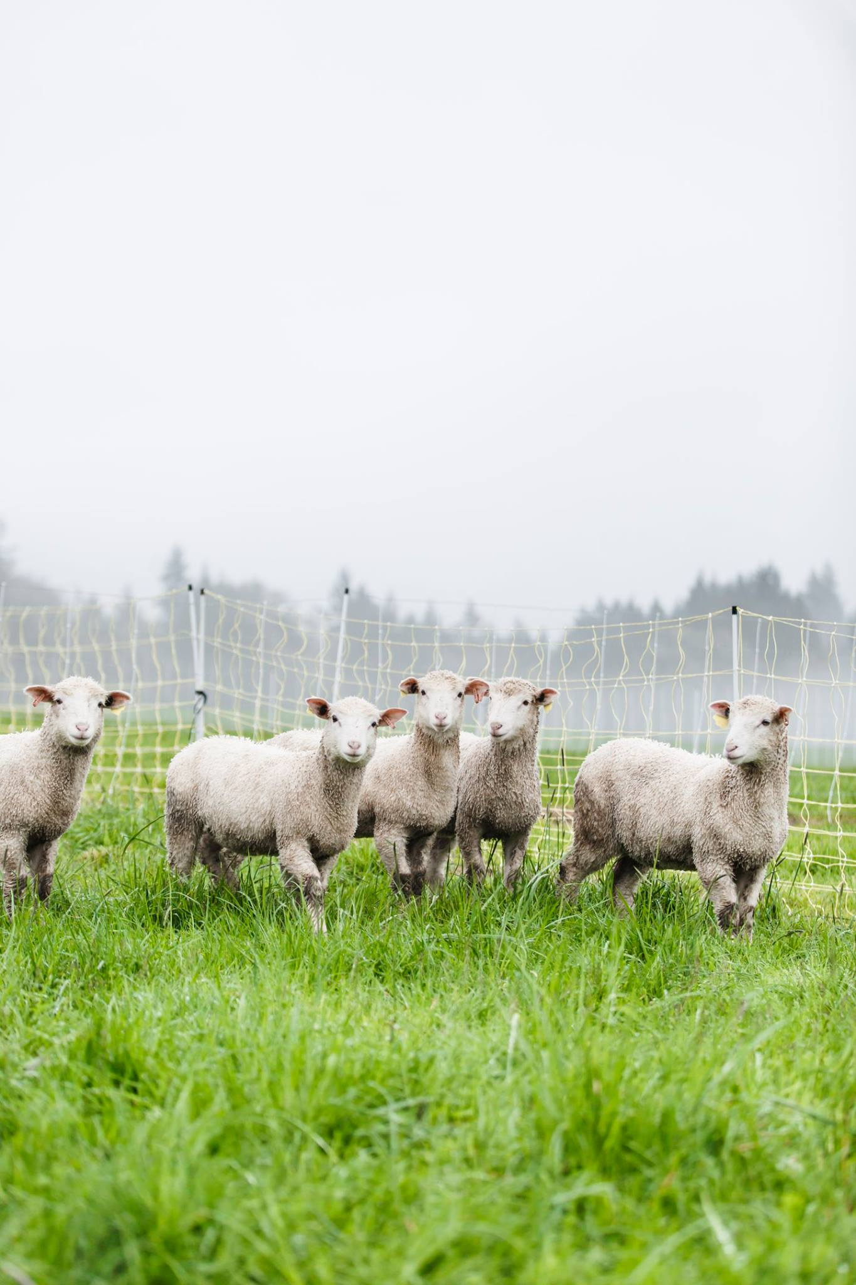
Energy requirement of grazing animals
Liveweight change: Varies depending on the amount of gained made and composition. As animals mature they deposit more fat relative to protein and require more energy for each kg gain made
These costs are:
15-20 MJ ME per kg gain for young stock (pre-weaning)
25-40 MJ ME per kg gain for growing stock
40-50 MJ ME per kg gain for dairy cows.

Slide 24
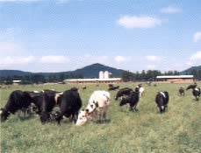
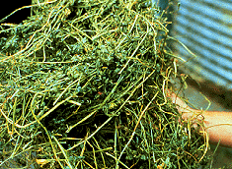
Forage intake
Ad libitum (voluntary intake): amount of forage consumed when unrestricted. Affected by:
  Forage characteristics
  Animal species
  Sex
  Physiological status
  Health status

Slide 25
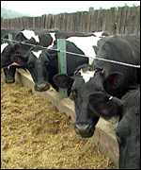
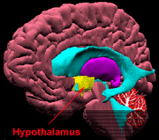
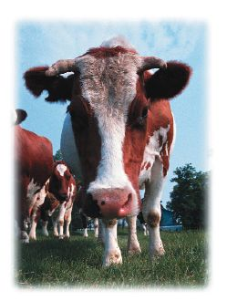
Intake regulation
Complex regulation including:
  Physical limitations
    Distention, stretch sensors
    NDF concentration, rate of digestion
  Physiological control
    Hypothalamus, hunger / satiety control
    Osmolarity of rumen/reticulum fluid
    Decrease in rumen fluid pH to 5.0-5.5
    Acetic acid concentration increases
  Psychogenic factors
    Herd behavior
    Palatability
    Environmental stresses

Slide 26
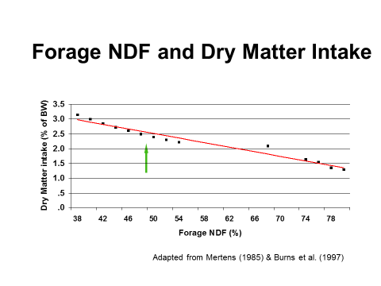

Slide 27
Intake
Intake is a function of a range of factors:
Pasture mass, pre and post grazing important
%dead / % green
Legume content
Climate
Physiological state

Slide 28
Intake
Intake is a function of a range of factors:
Liveweight and body conditions-Large animal consume more
Lactation-Lactating animals consume more
Pregnancy- Energy intake increases in the last third of pregnancy but response to feed intake is often small.
Climatic conditions- they eat more in cold conditions and less in high temperatures.
A dairy cow producing 25 lt. milk daily will eat more that a cow yielding 15 lt. whatever the sward conditions.

Slide 29
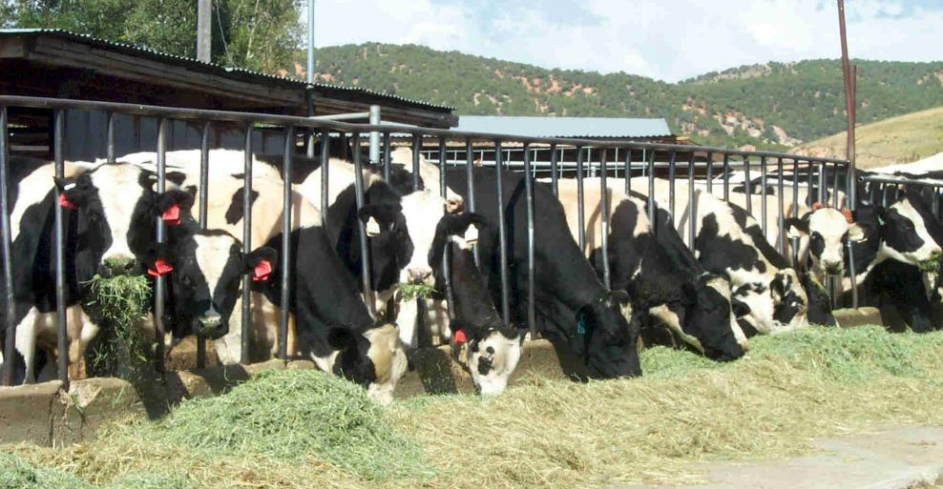
Digestive process rates
Digestion speed greatly affects animal performance:
  Digestion rate (k)
    Percentage of remaining material digested each hour
  Rate of particle size reduction
    Reduced to approximately 0.1 inch before passage
  Rate of passage
    Can vary from 24 – 48 hours; affects intake

Slide 30
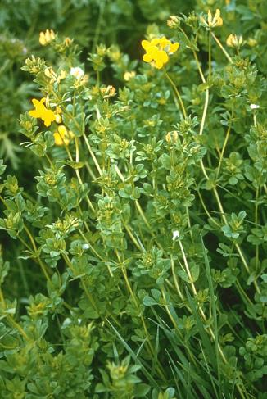
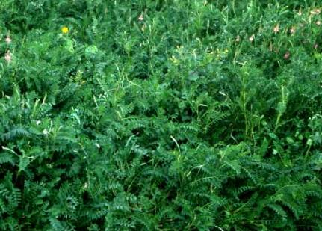
Nitrogen nutrition
Utilization limited by N if forage < 6-7% crude protein
Improved, managed forages usually energy-limited
Range or C₄ grass forage may be N-limited
Rumen degradable protein
85-95% of herbage protein degraded to NH₃ in rumen
Absorbed by rumen organisms to synthesize new microbial protein
Escape, by-pass, protein
Enters the abomasum via the omasum
Forages with tannin have more by-pass protein
Birdsfoot trefoil
Sainfoin

Slide 31
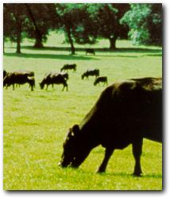
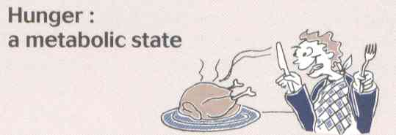

Grazing utilization
Grazing typically:
Lowers production costs
  No expenses for harvesting, storing, or feeding
Increases energy used for maintenance (NEm)
  Decreases net energy available for growth and production (NEp) [variable based on quality]
Is controlled by hunger/satiety stimuli
  Neurohormones

Slide 32
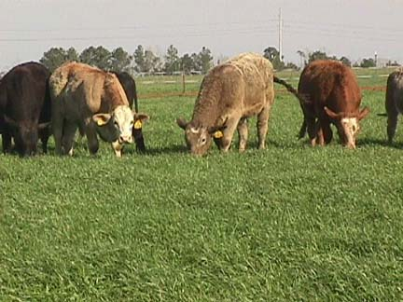
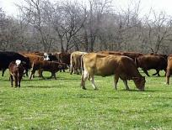
Grazing processes
1000 pound cow:
Requires 30 lb dm/day (3% body weight)
  No expenses for harvesting, storing, or feeding
Stocking rate depends on: FOO (forage on offer), RDM (residual dry matter), % utilization, time on paddock
  If 2500 lb/a FOO and 1200 lb/a RDM = 1300 lbs available
  If 75% utilization = 975 lbs/a utilizable (1300*0.75)
  If 3-day sets, required forage is 90 lb/cow
  975 lb/a utilizable forage / 90 lb/cow = 10.8 cows/a

Slide 33
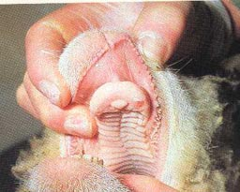
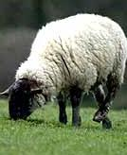
Grazing machanics
Sheep and cattle:
  tongues and lips to select
  clamped between incisors and dental pad
  sharp rotation of head to tear herbage from the plant

Slide 34
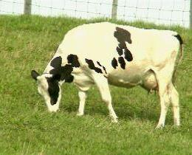

Grazing dynamics
Intake per day (I) is determined by:
Rate of intake (RI)
Time spent grazing (GT)
I = RI * GT
To consume 3% body weight in dry matter, a 440-lb animal would have to take 6000 typical-sized bites per day;
at 20 bites per minute, this would require 5 hours.
Cattle seldom graze for more than 12-14 hours, due to time needed for rumination and other individual and social activities.

Slide 35
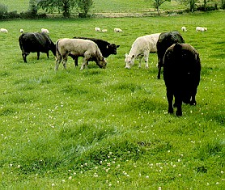
Intake and Herbage Allowance
Herbage allowance: “Amount of herbage available to each livestock unit per unit of time”
  Intake increases up to 0.5 lb / 100 lb BW / hr grazing as allowance increases up to 1.0 lb DM / 100 lb BW

Slide 36
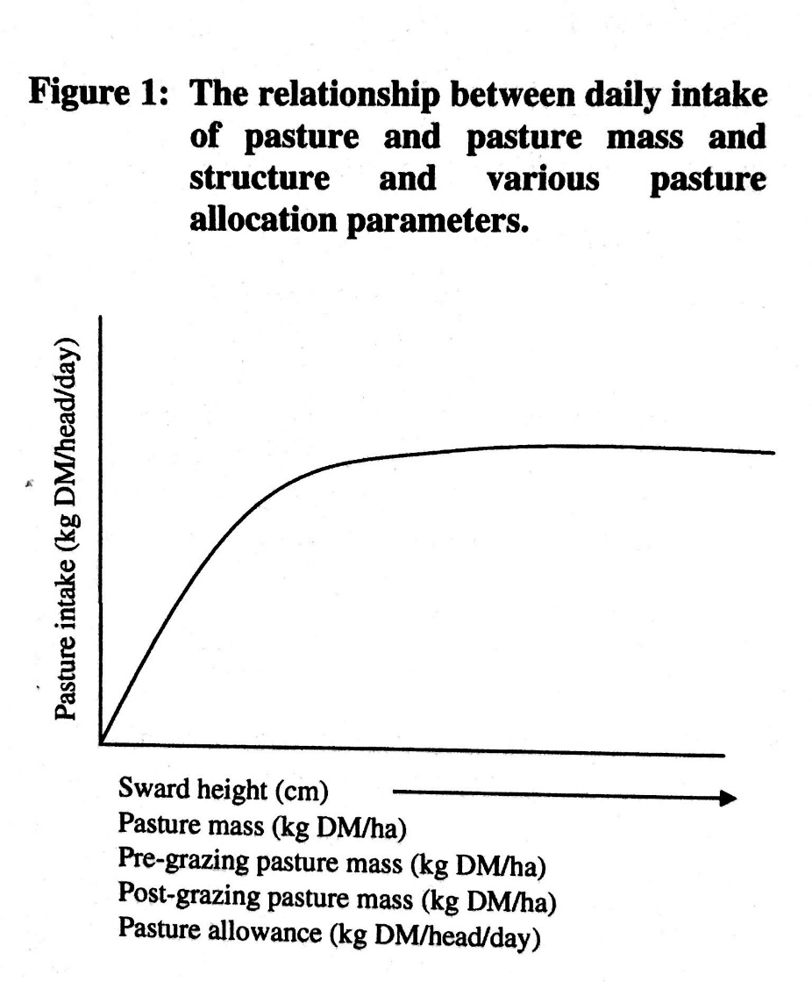
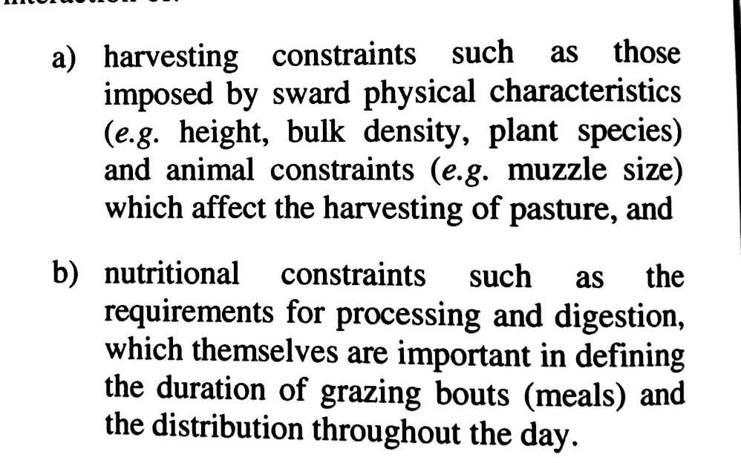
Pasture structure and the daily feed intake
In broad terms, intake will reflect the interaction of

Slide 37
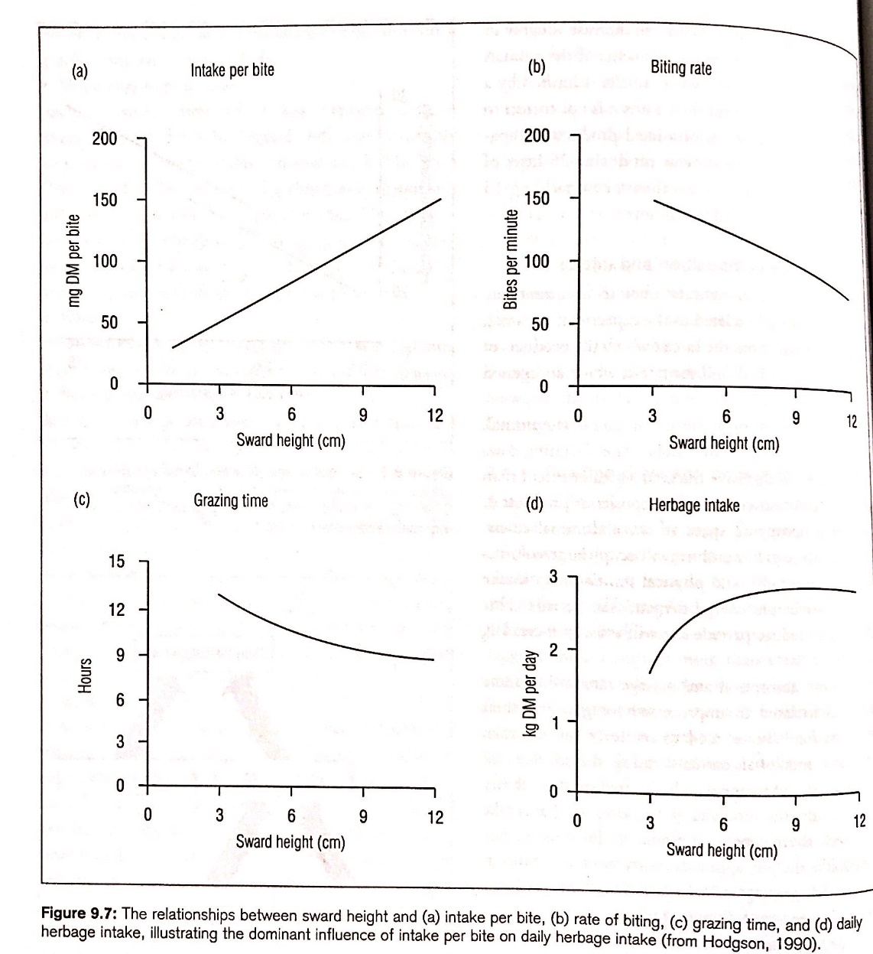
FI = time X bite size X bites per minute
The taller, more dense the forage, the more forage an animal will get per bite
If forage is short, animals waste energy trying to take the last little bites

Slide 38
Practical Implications
Pasture botanical and morphological composition is a good indicator of quality, and can be used to estimate ME.
High feeding value pastures have attributes
- high legume content
- high leaf content
- low stem content
- young herbage age
- grown at cool temperatures

Slide 39
Summary of Forage Utilization
The symbiotic relationship between digestive tract microorganisms of herbivores and their host animals allows humankind to benefit from energy that would otherwise be unavailable to mammals.
Ruminants (e.g. cattle, sheep, and goats) are foregut fermenters whereas nonruminants (horses and rabbits) are hindgut fermenters.
Digestive tract microbes produce enzymes that degrade cellulose and hemicellulose and produce VFAs (acetic, propionic, butyric).
Forage intake is affected by: forage characteristics, animal species and sex, and physiological and health status.
Forage digestibility is greatly affected by stage of maturity, since that affects protein, fiber, and lignin content.
Sheep and cattle use their tongues and lips to select forage, clamp it between incisors and dental pad, and use a sharp rotation of head to tear herbage from the plant.
Horses bite rather than shear forage (upper & lower incisors).

Slide 40
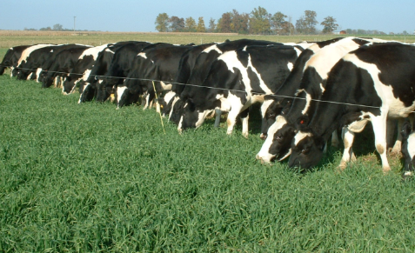
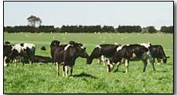
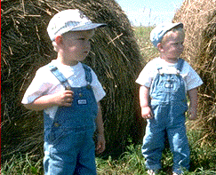
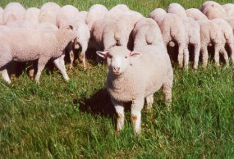
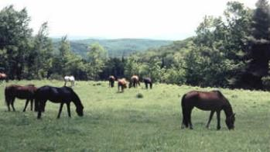
Summary of Forage Utilization (cont.)
Cattle seldom graze for more than 12-14 hours, due to time needed for rumination and other individual and social activities.
Herbage allowance affects animal intake.
In nonruminants (equids), ingested protein is hydrolyzed to amino acids in the stomach and passed to the small intestine for absorption.
In dairy cattle, increasing concentrate could not compensate for the negative effects of late maturity hay on digestible dry matter intake.

Slide 41
References
Publications
  Forages: An Introduction to Grassland Agriculture Vol. 1, 6th Ed.
    Chapter 17: Forage Utilization (Charles Dougherty and Michael Collins)
  PNW 614: Pasture and Grazing Management in the Northwest
    Chapter 11: Pasture Plant Composition and Forage Nutritional Value
Websites
  Forage Information System (forages.oregonstate.edu)
    National Forage & Grasslands Curriculum
      http://forages.oregonstate.edu/nfgc/
Media
  Videotape: “Who’s Coming to Dinner?”
    OSU Extension and Experiment Station Communications, 1998. (https://www.agronomy.org/files/jnrlse/issues/1999/news-features-99.pdf)

